Slide 1
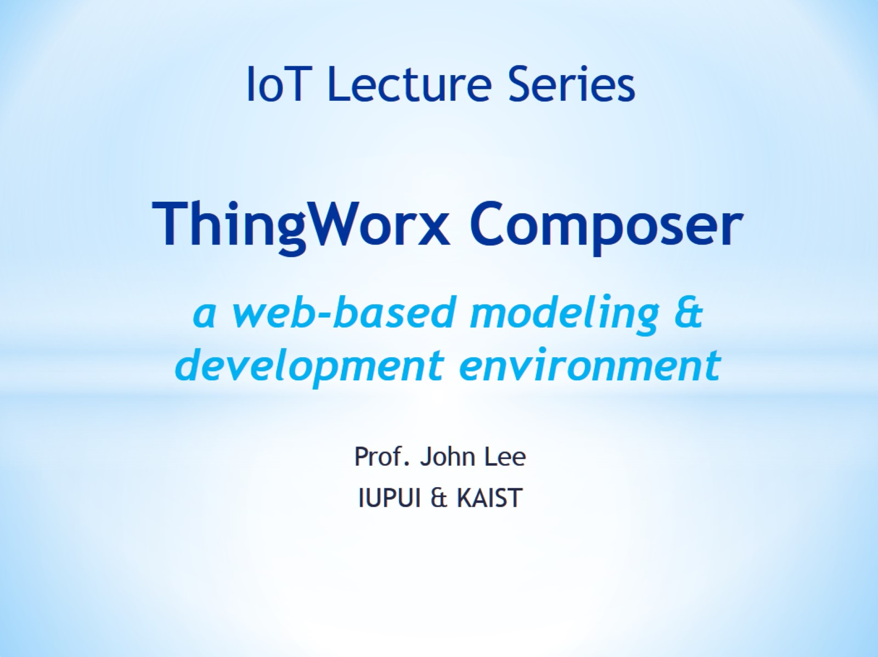
ThingWorx Composer a web-based modeling & development environment

Slide 2
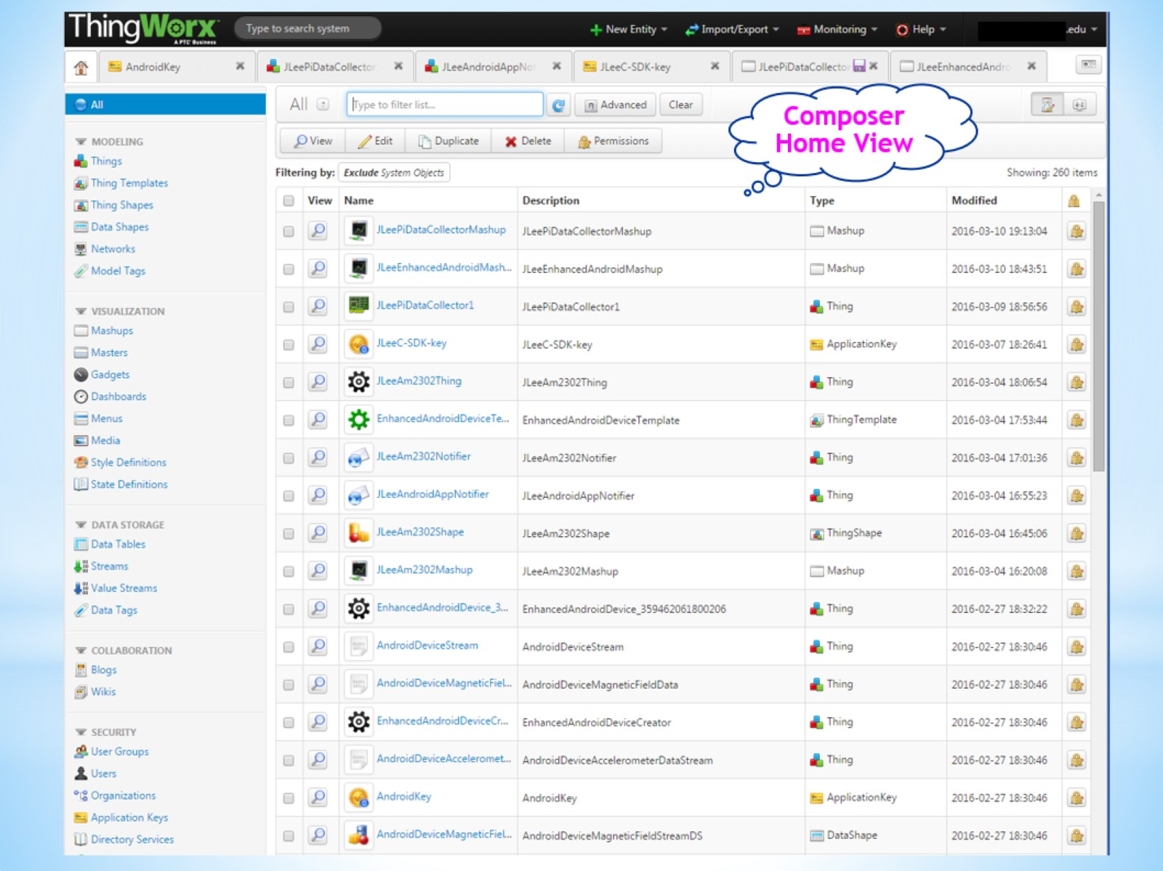

Slide 3
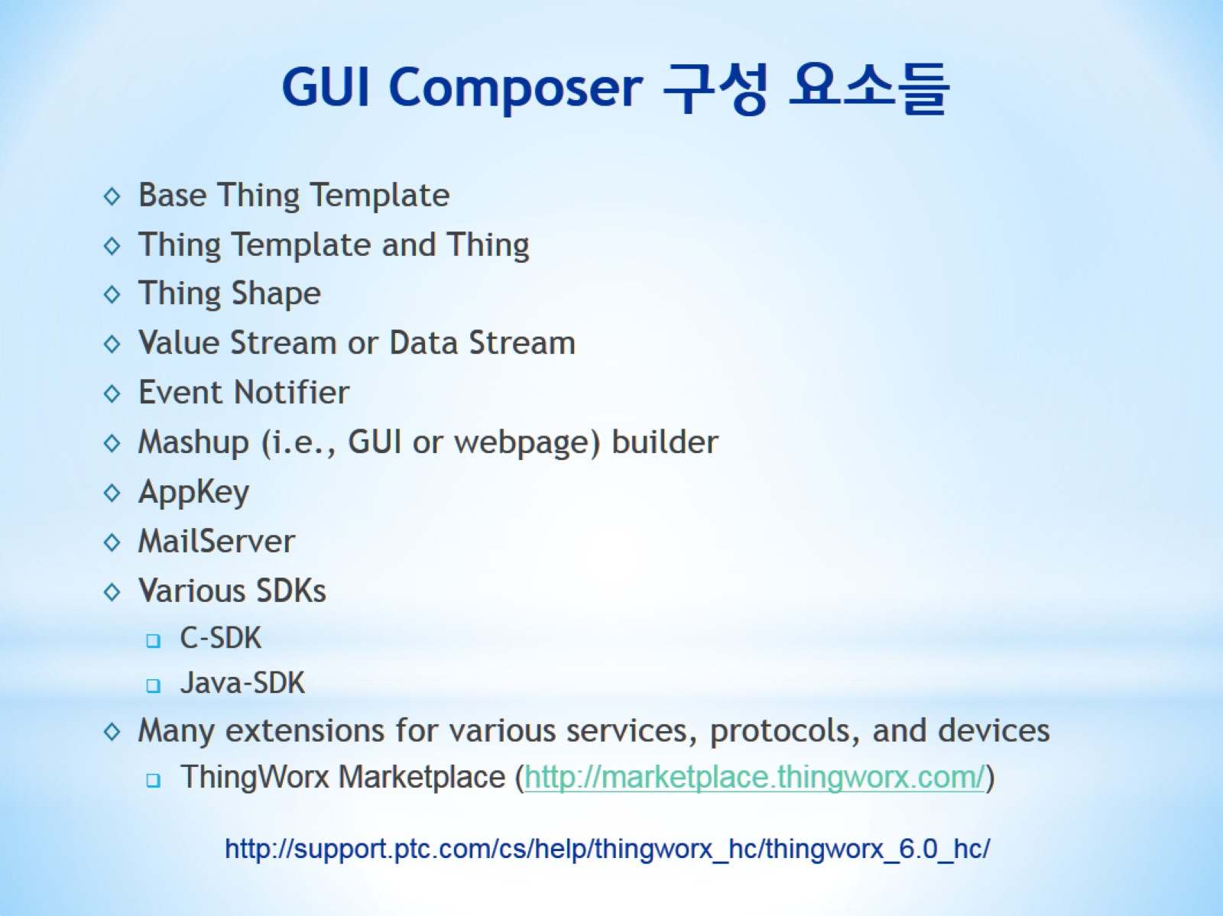
GUI Composer 구성 요소들

Slide 4
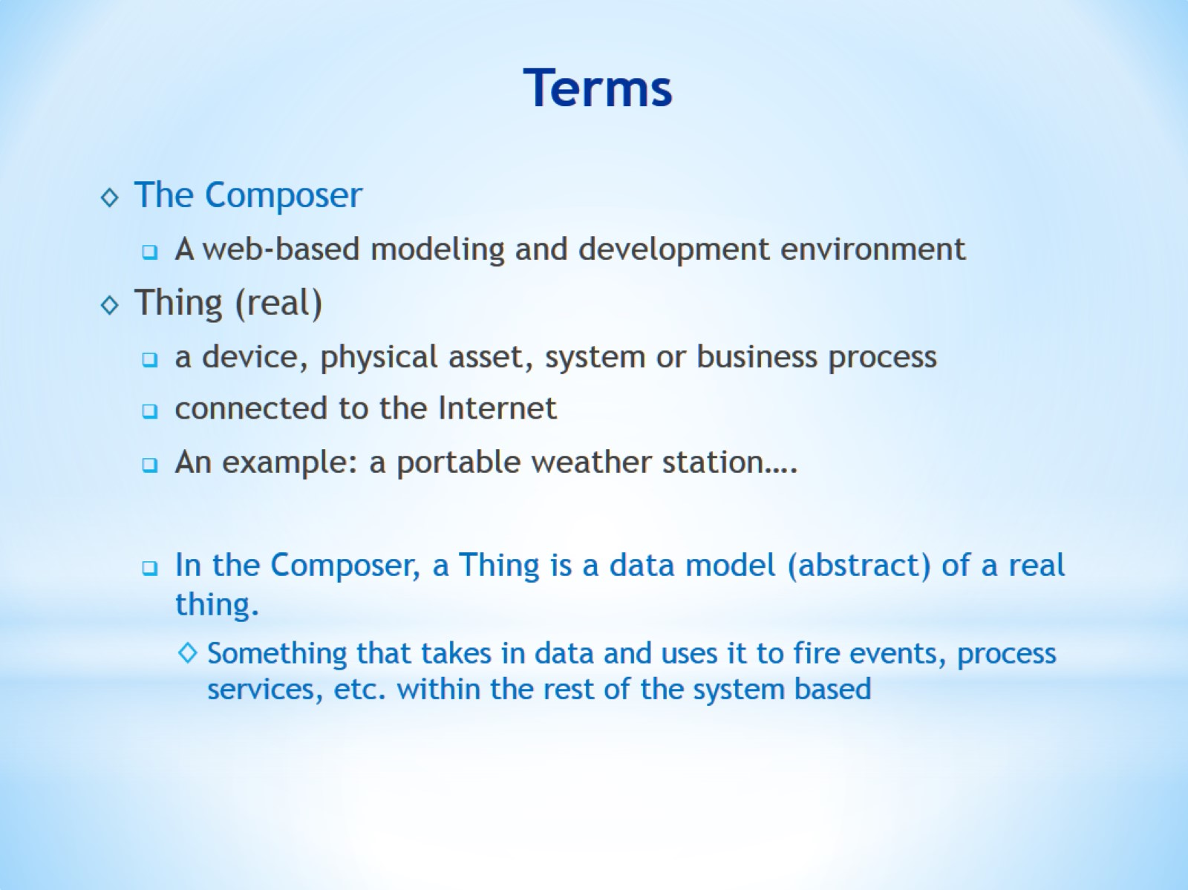
Terms

Slide 5
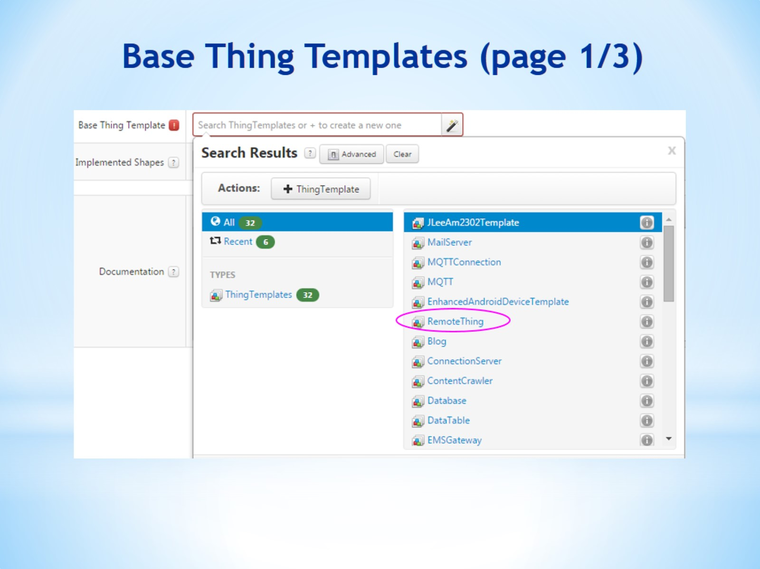
Base Thing Templates (page 1/3)

Slide 6
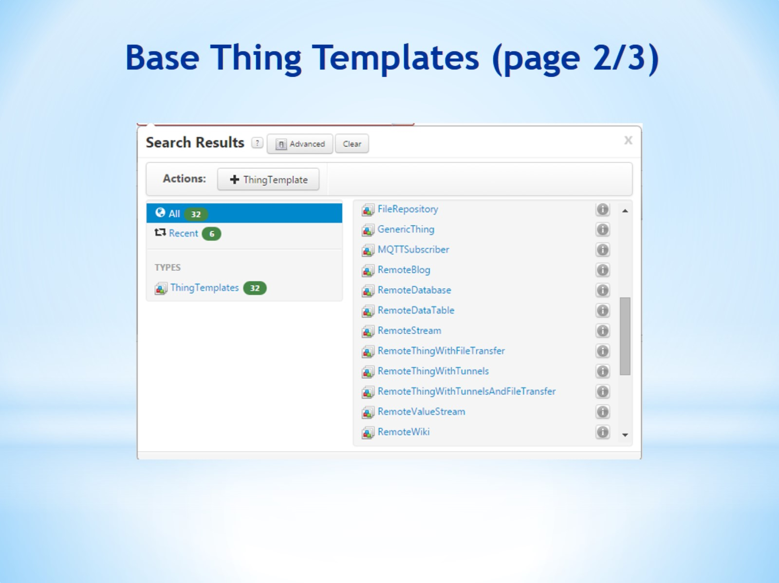
Base Thing Templates (page 2/3)

Slide 7
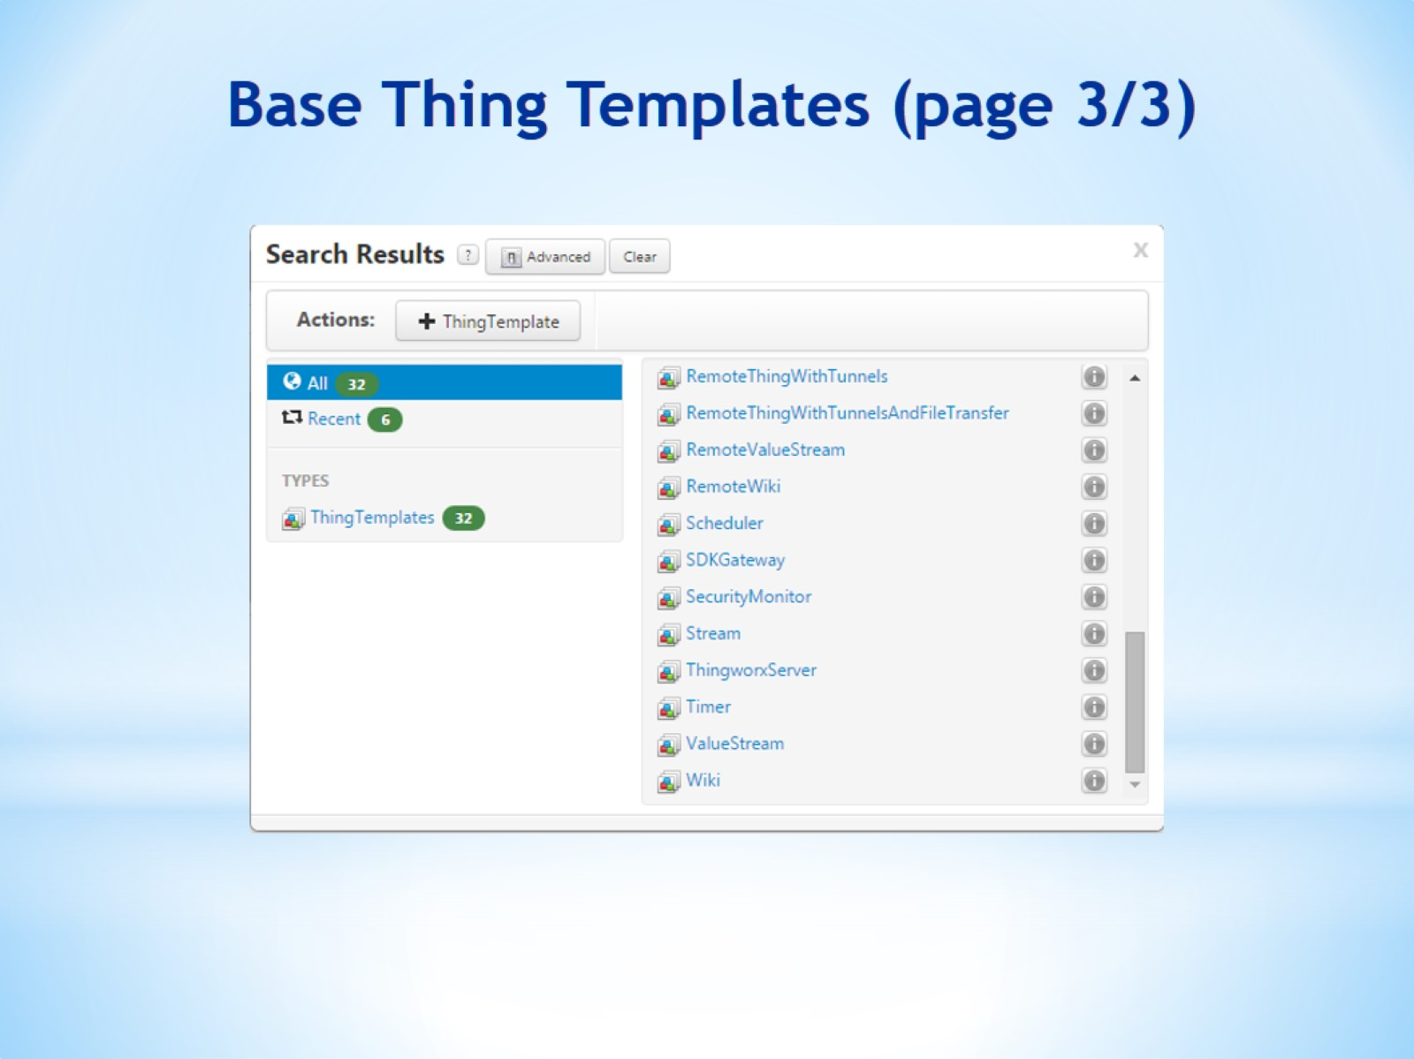
Base Thing Templates (page 3/3)

Slide 8
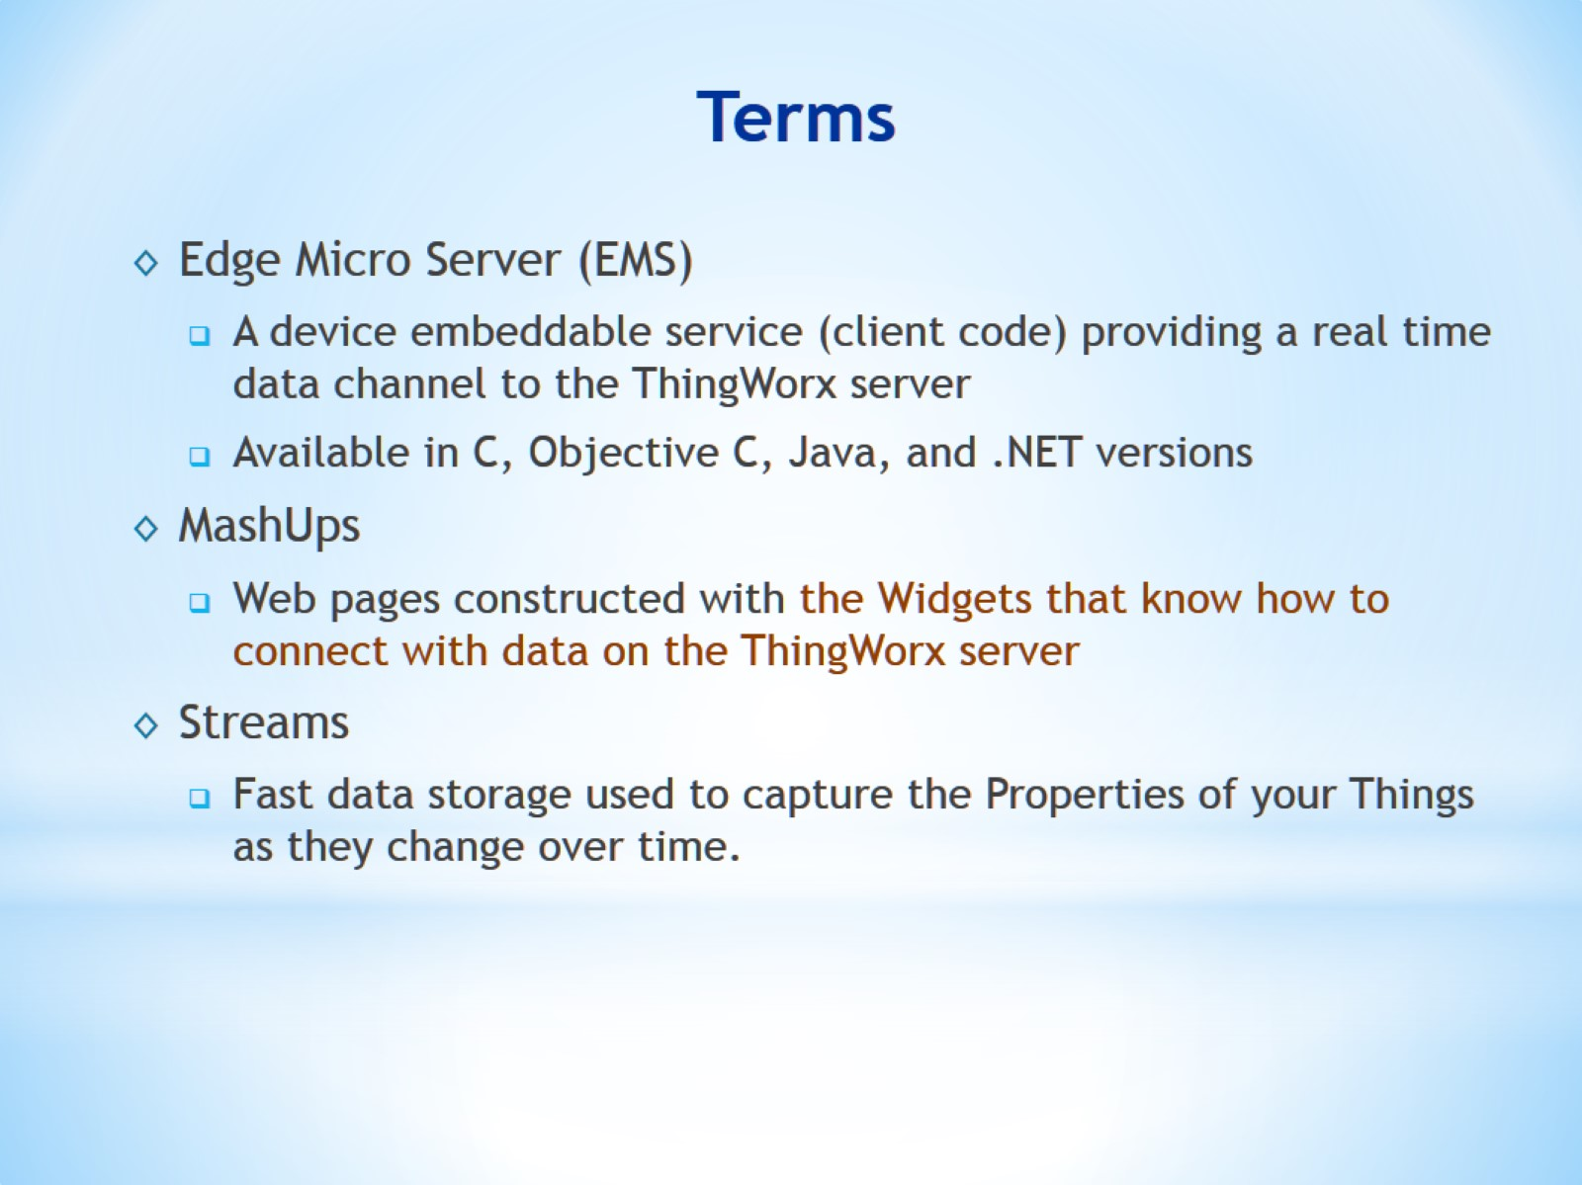
Terms

Slide 9
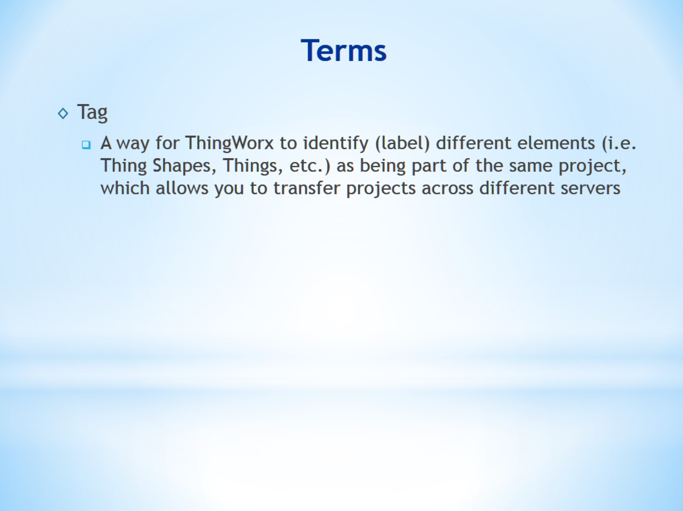
Terms

Slide 10
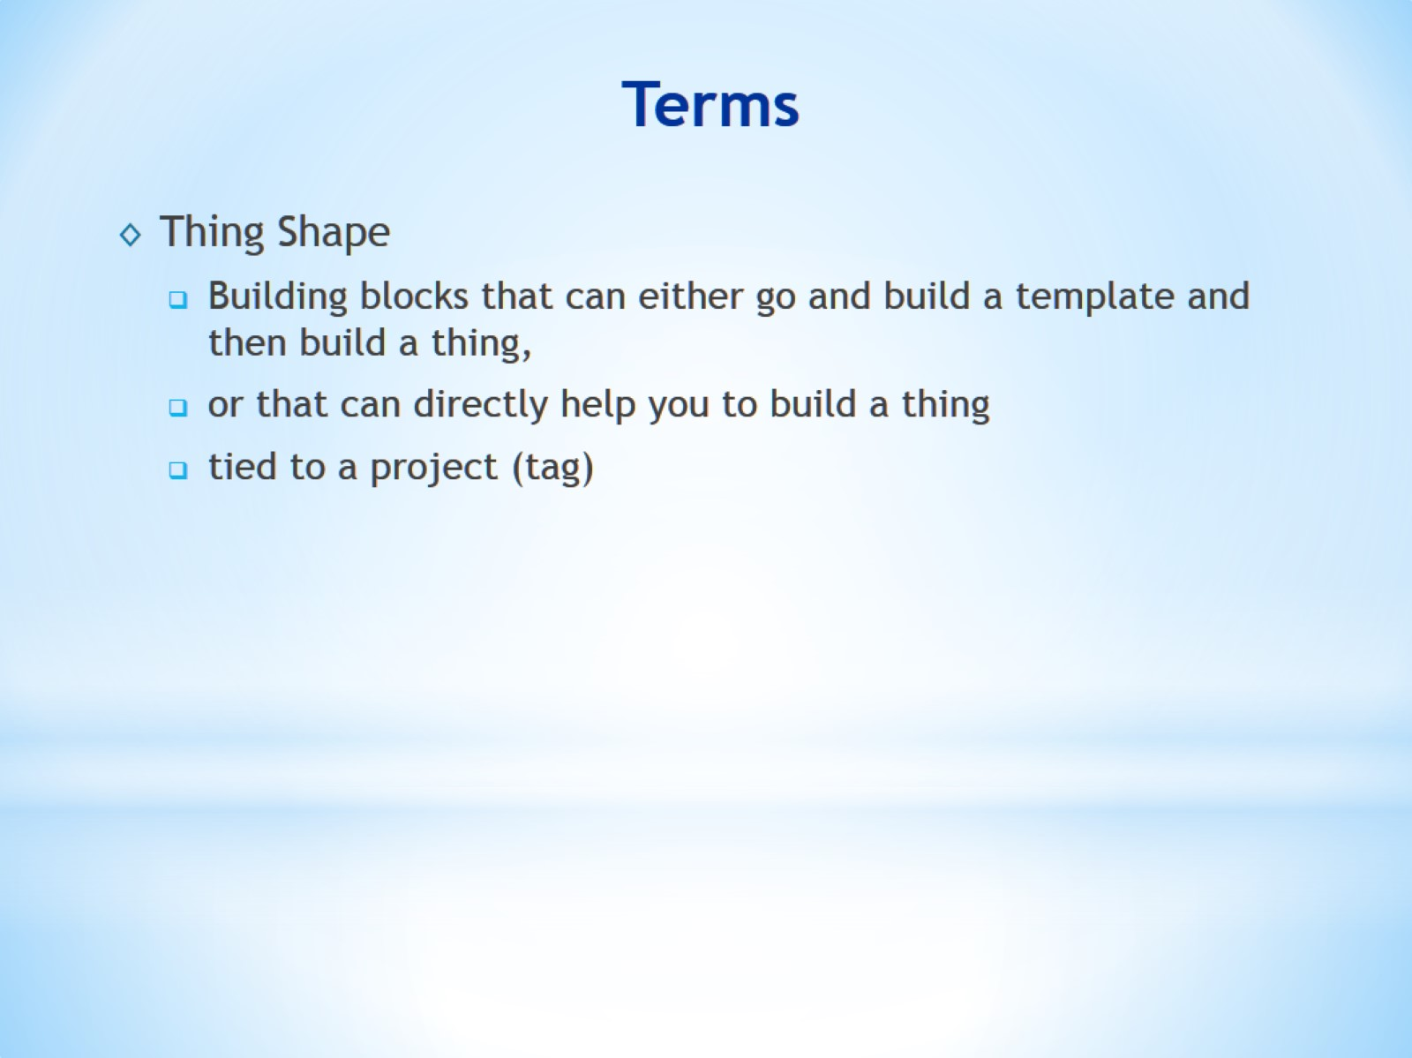
Terms

Slide 11
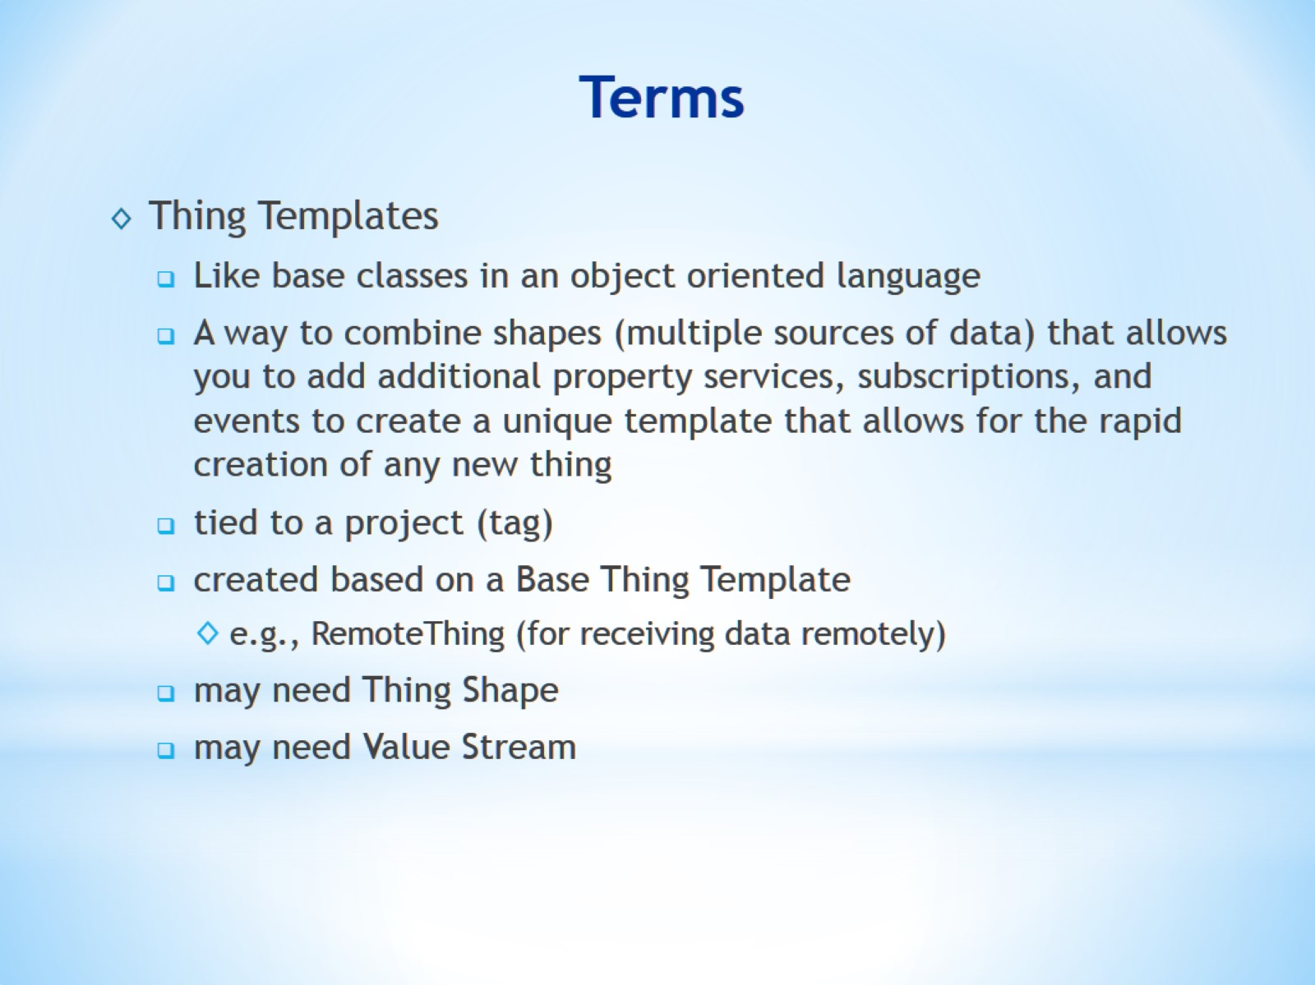
Terms

Slide 12
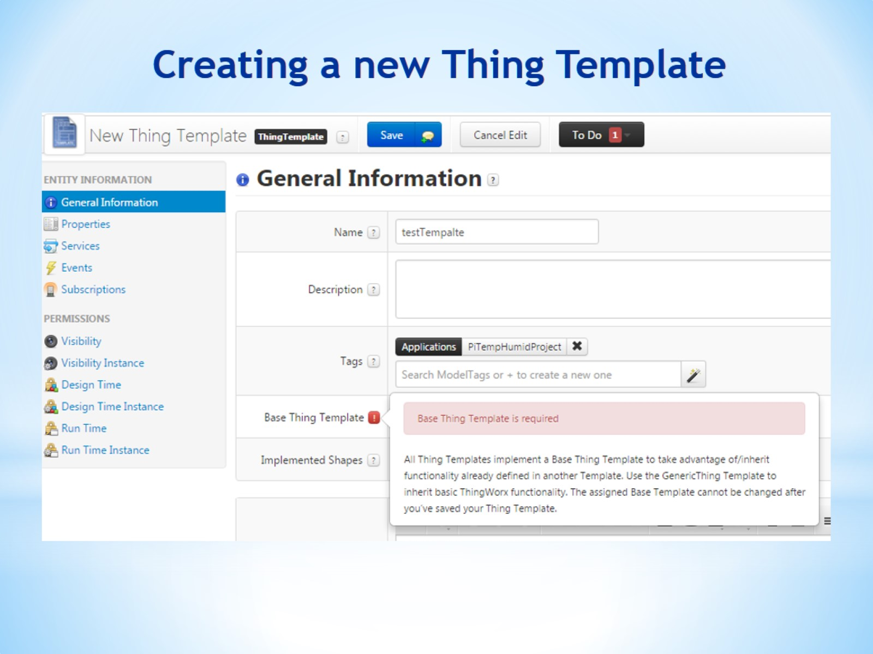
Creating a new Thing Template

Slide 13
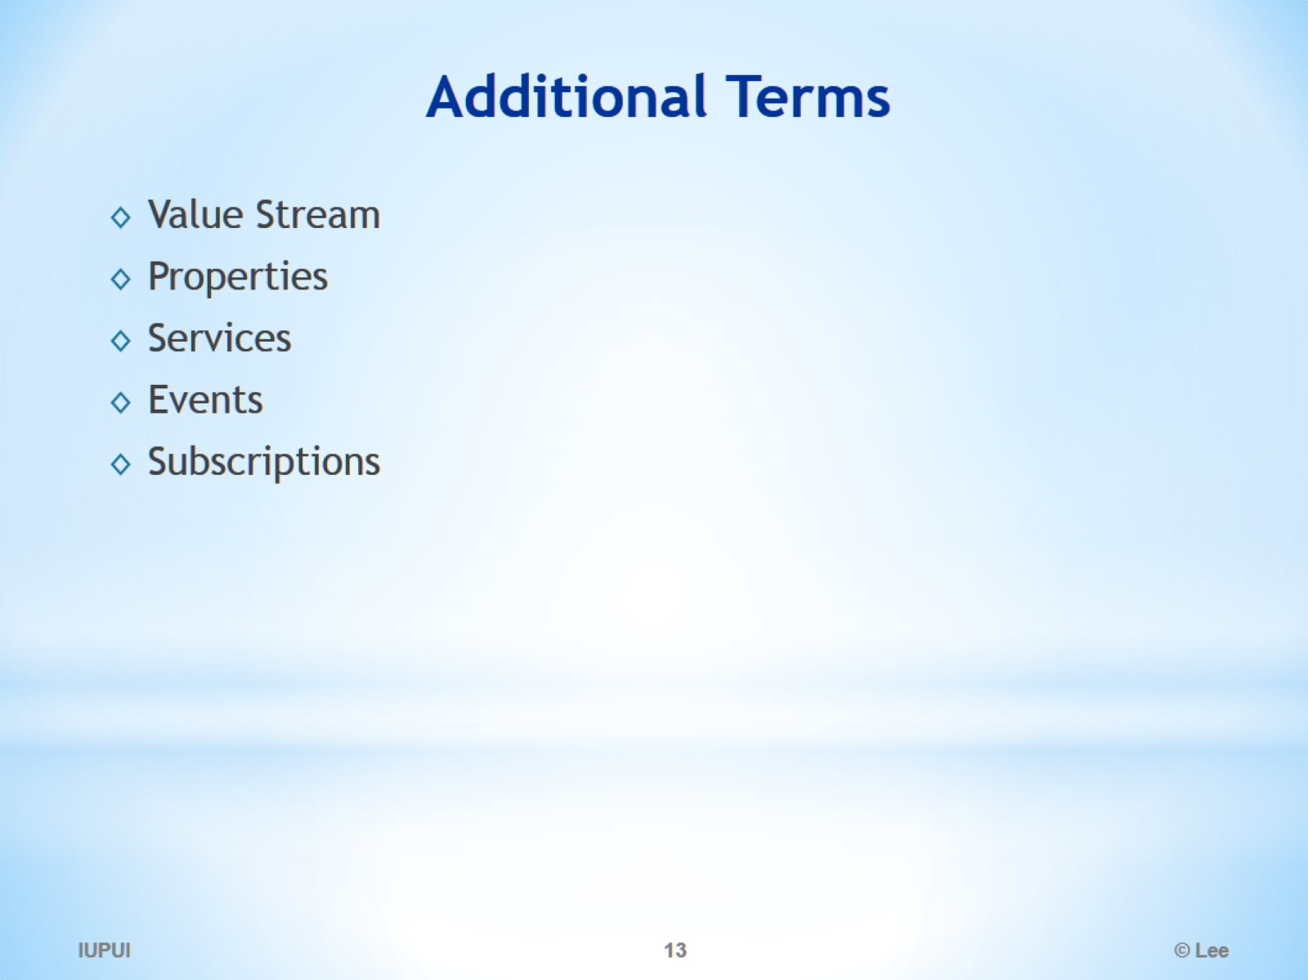
Additional Terms

Slide 14
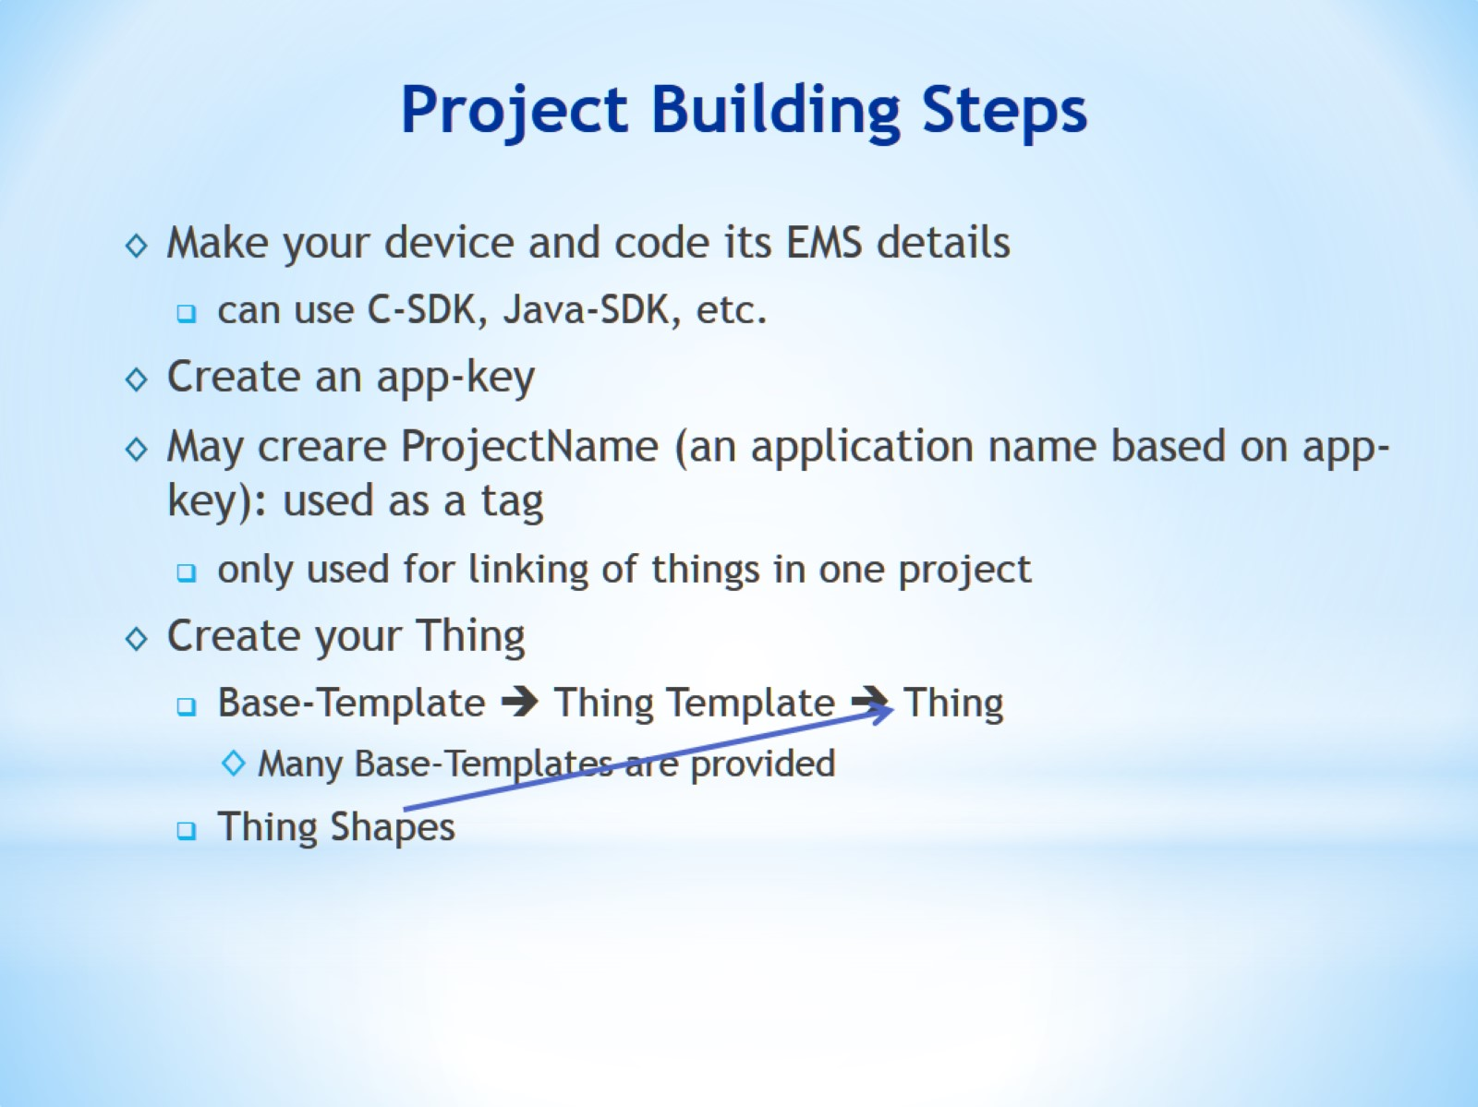
Project Building Steps

Slide 15
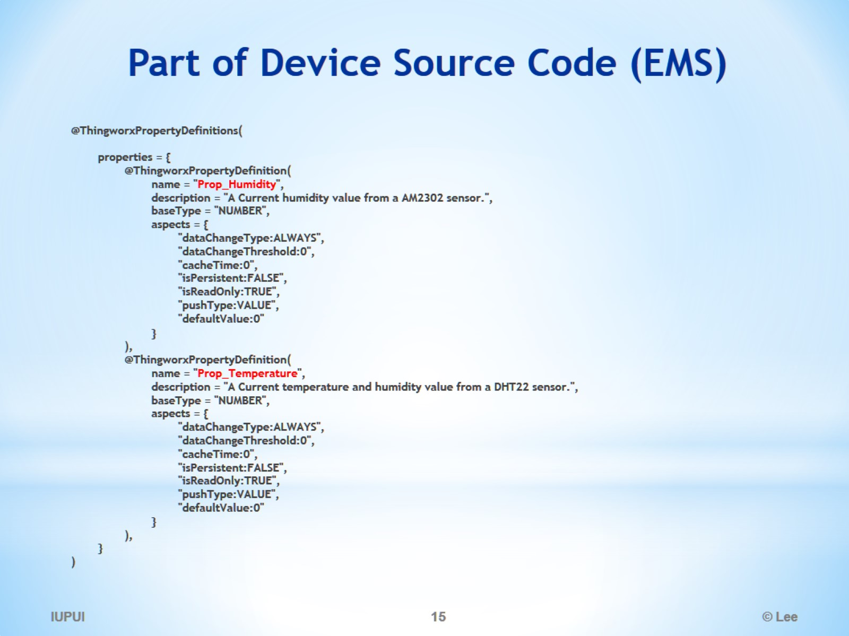
Part of Device Source Code (EMS)

Slide 16
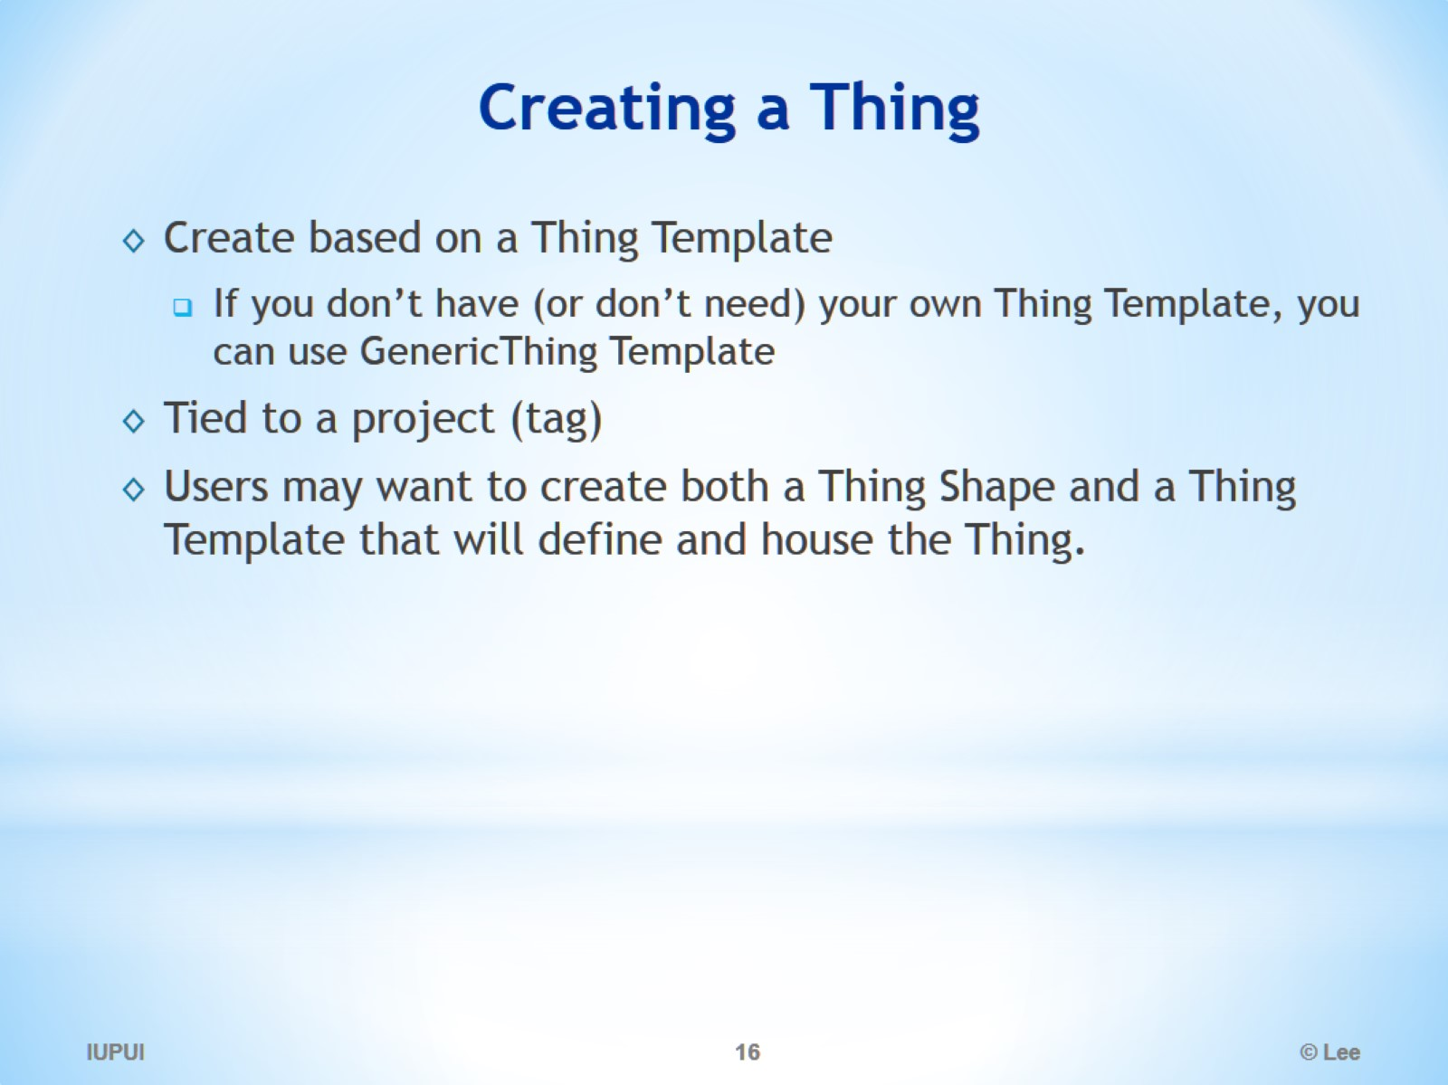
Creating a Thing

Slide 17
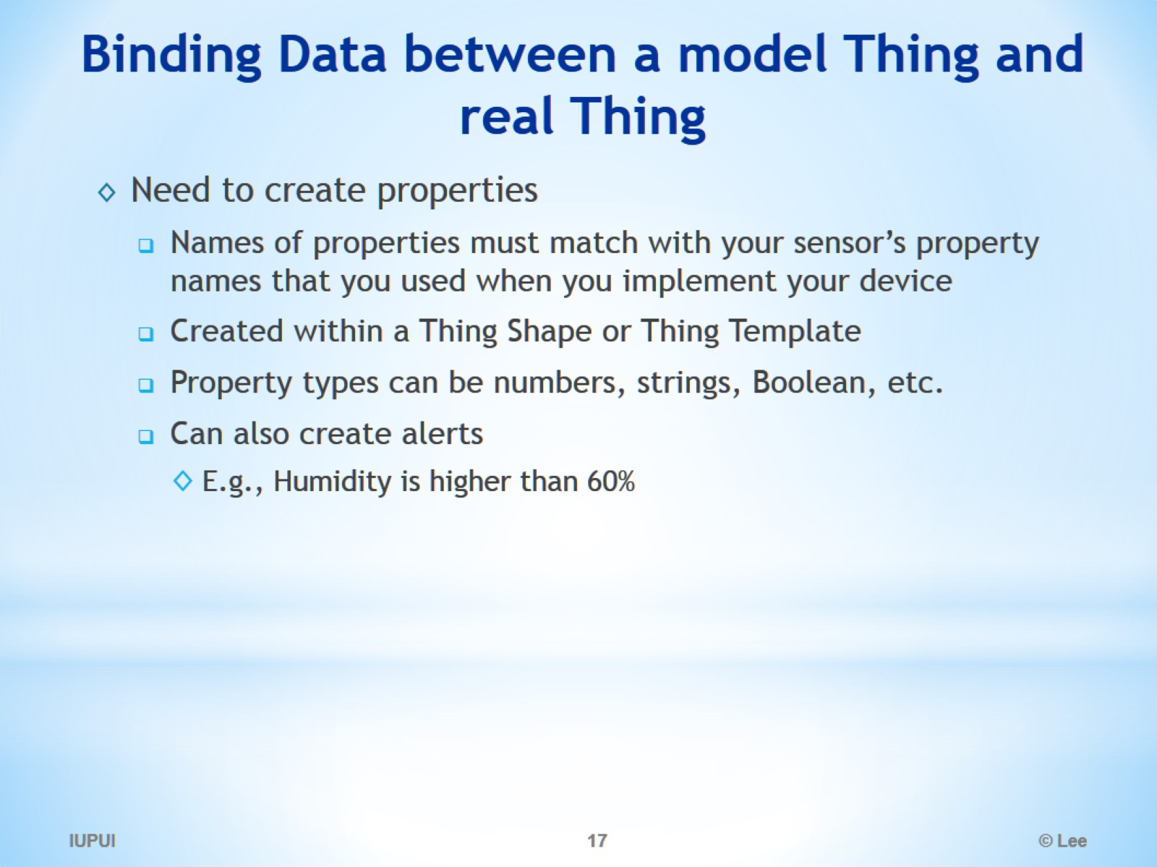
Binding Data between a model Thing and real Thing

Slide 18
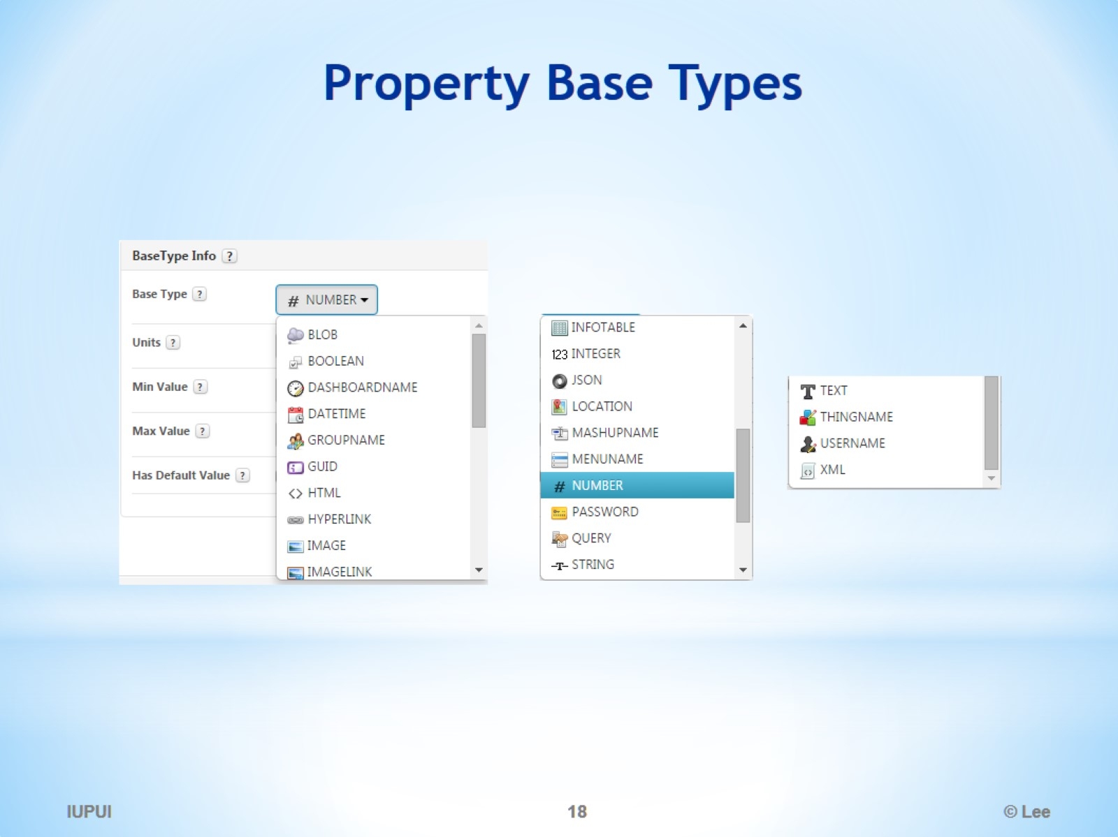
Property Base Types

Slide 19
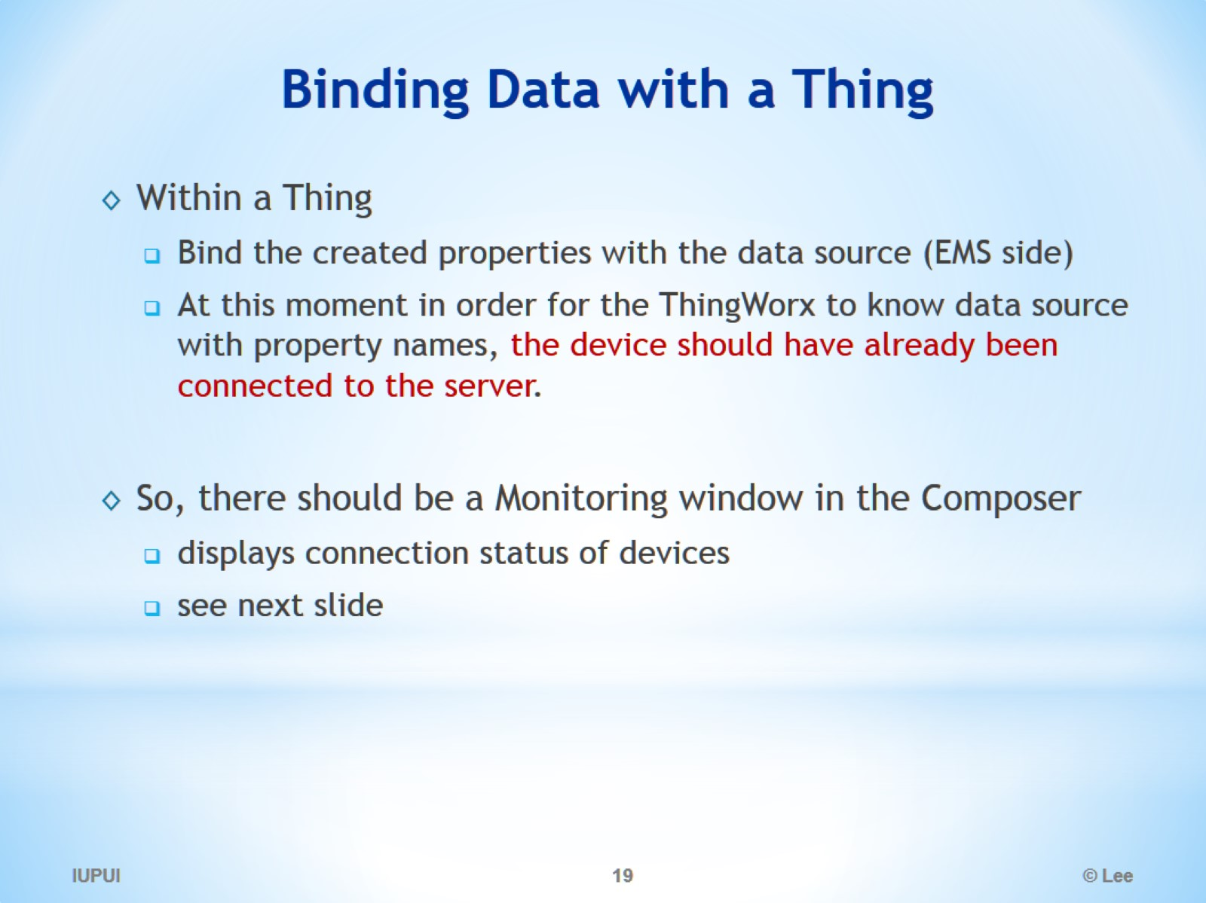
Binding Data with a Thing

Slide 20
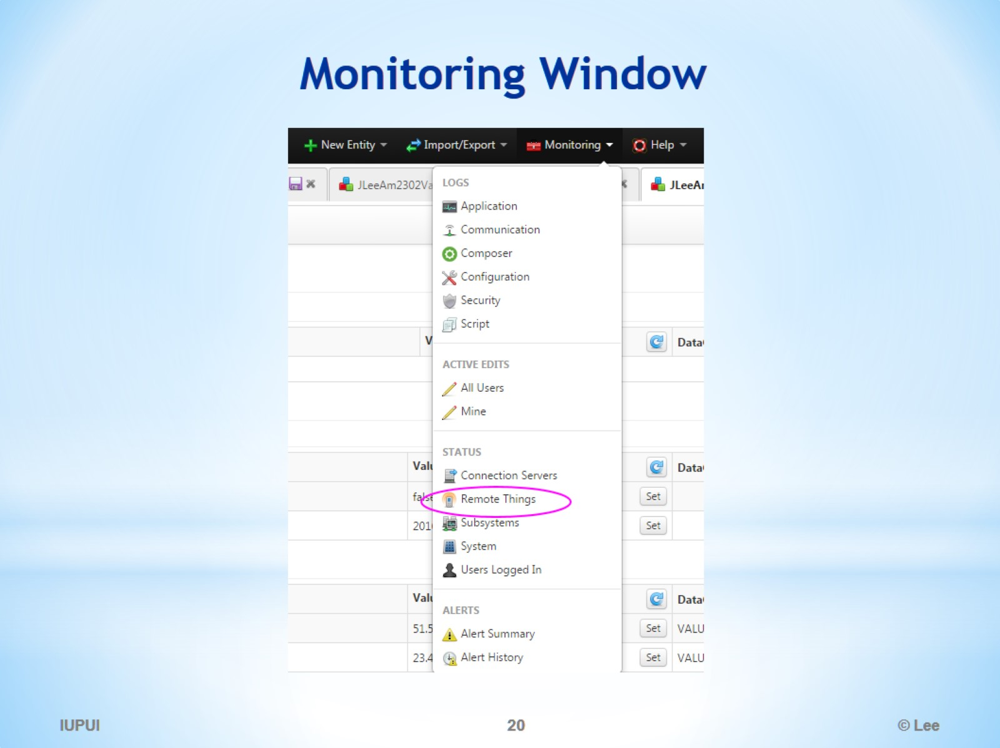
Monitoring Window

Slide 21
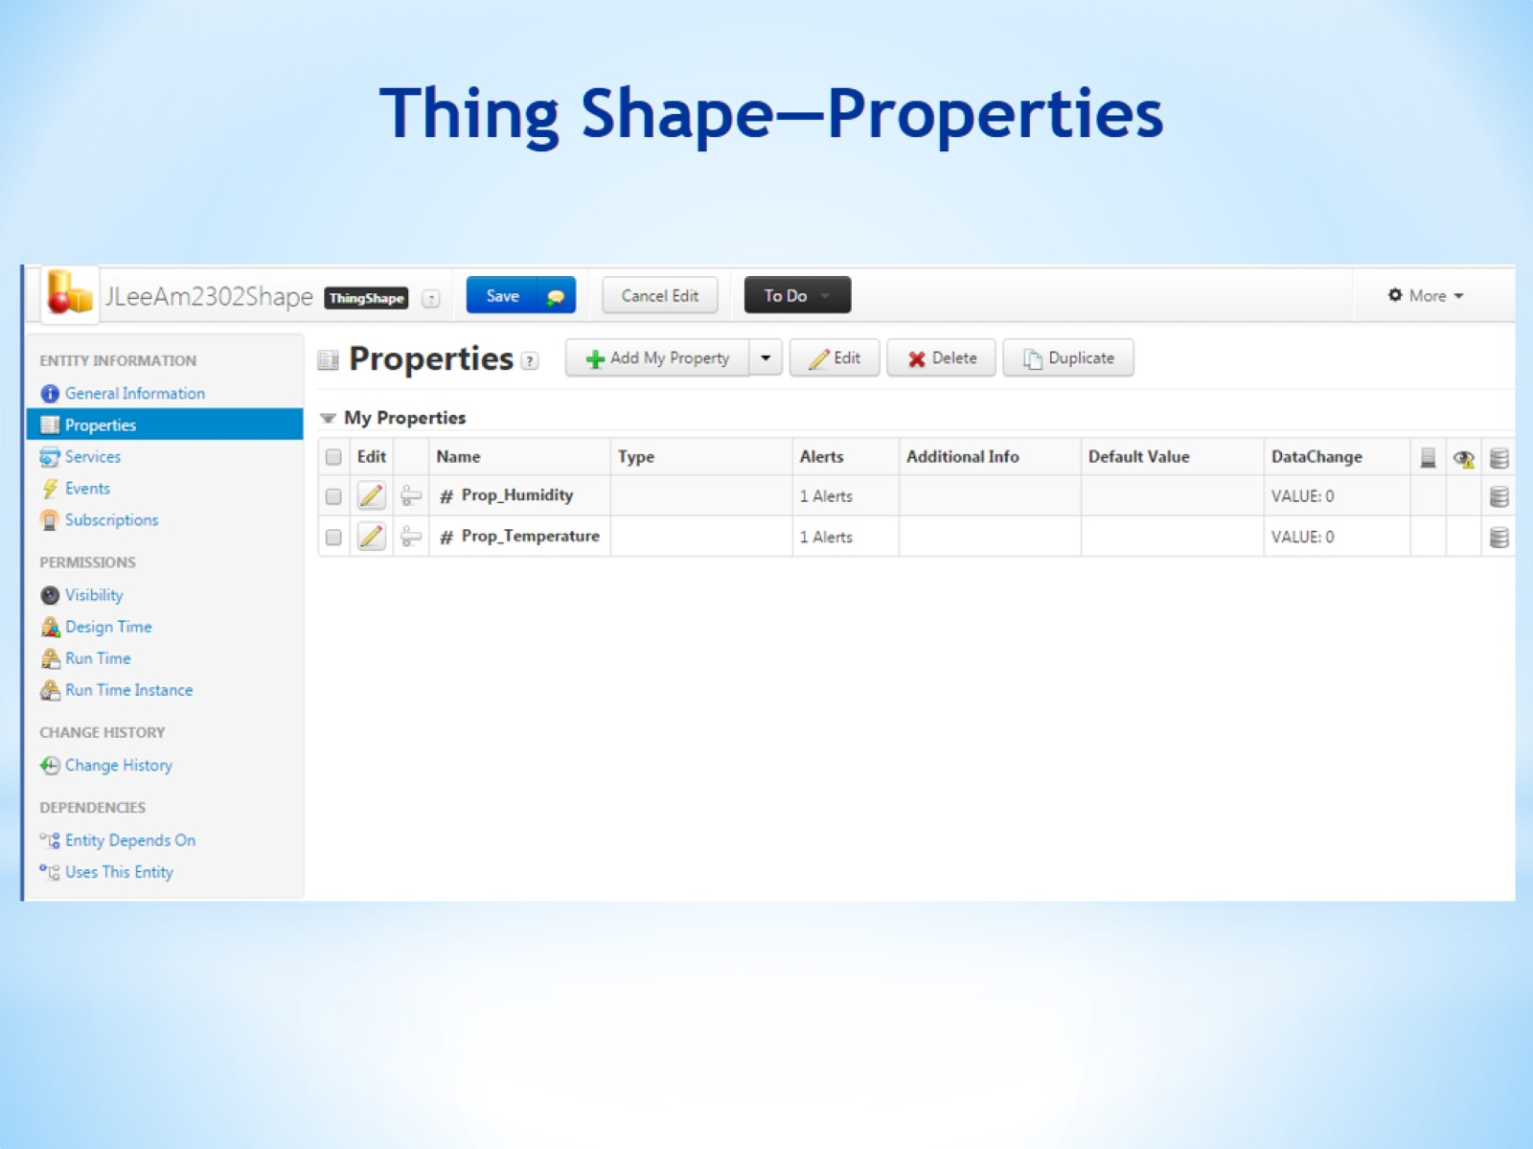
Thing Shape—Properties

Slide 22
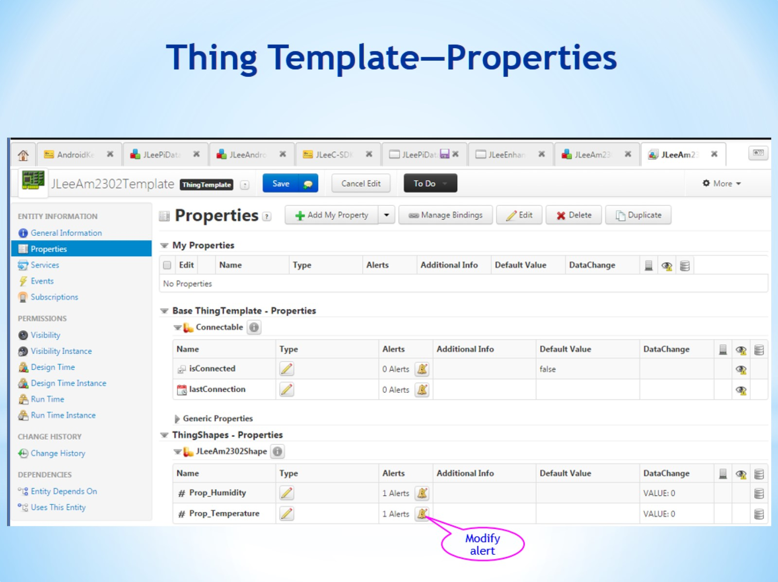
Thing Template—Properties

Slide 23
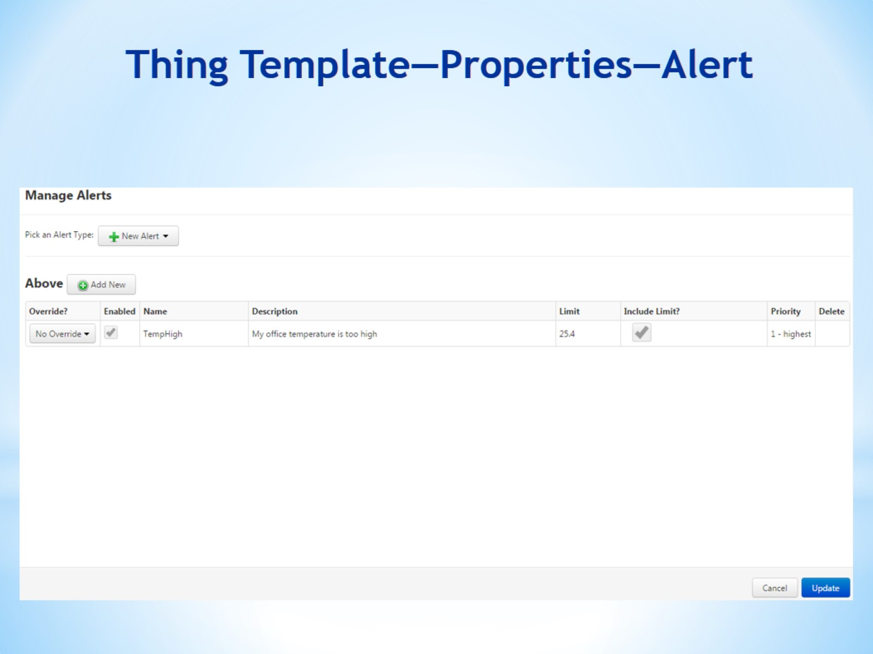
Thing Template—Properties—Alert

Slide 24
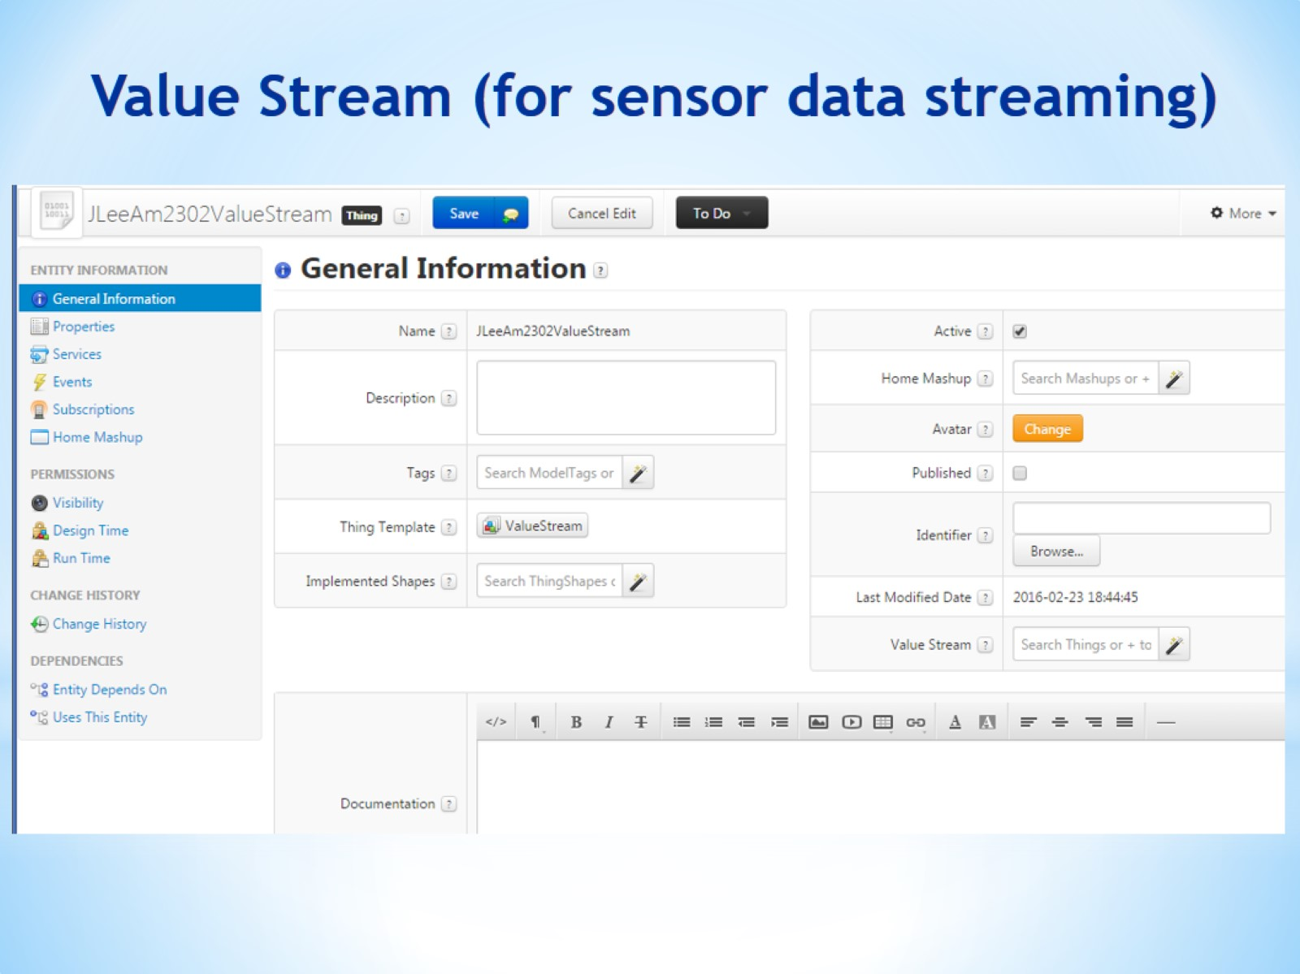
Value Stream (for sensor data streaming)

Slide 25
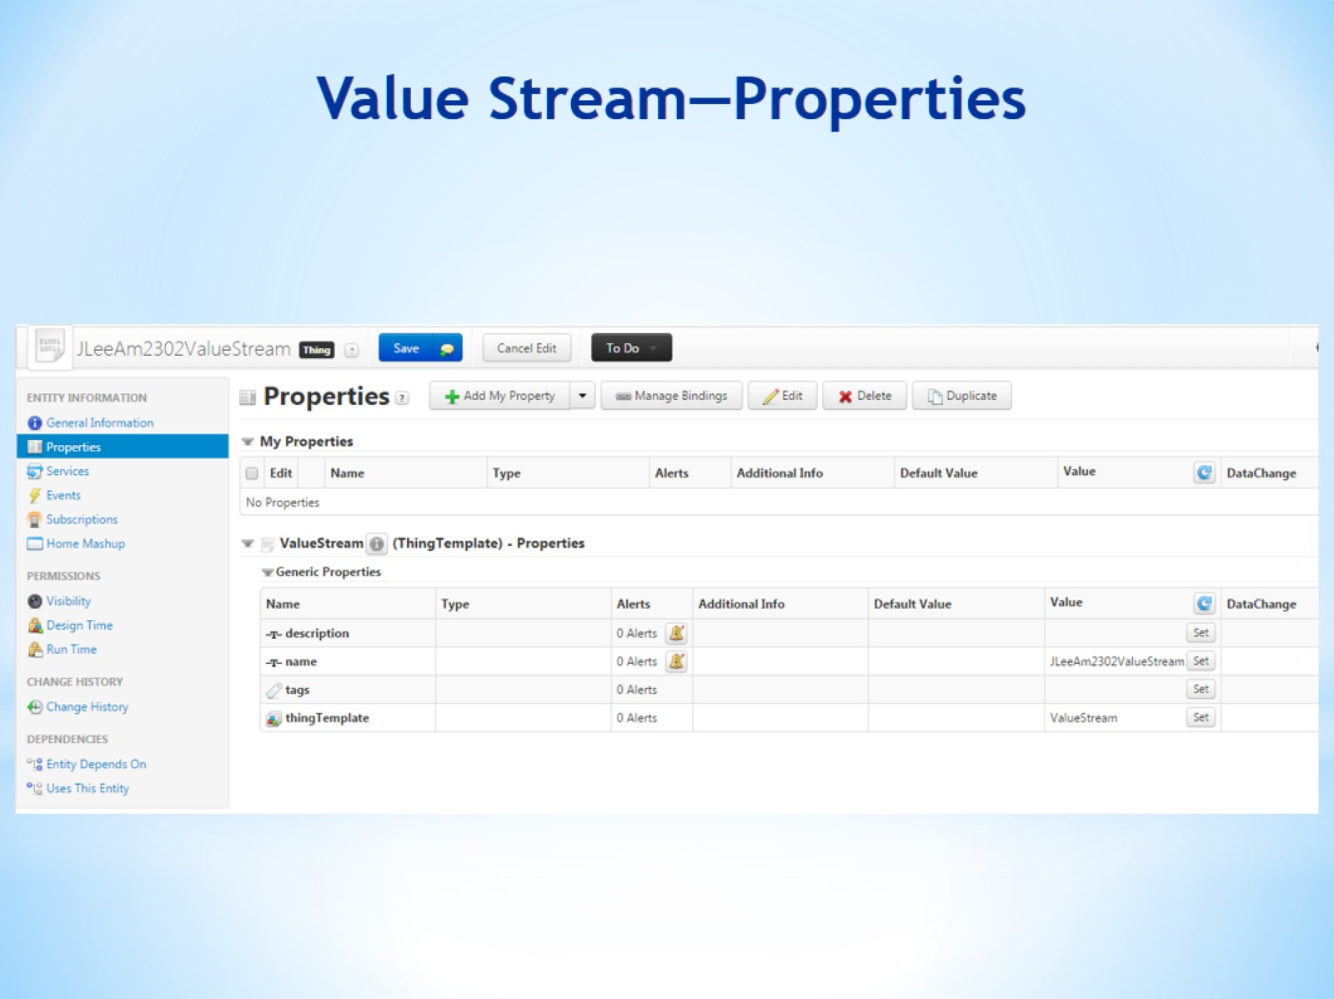
Value Stream—Properties

Slide 26
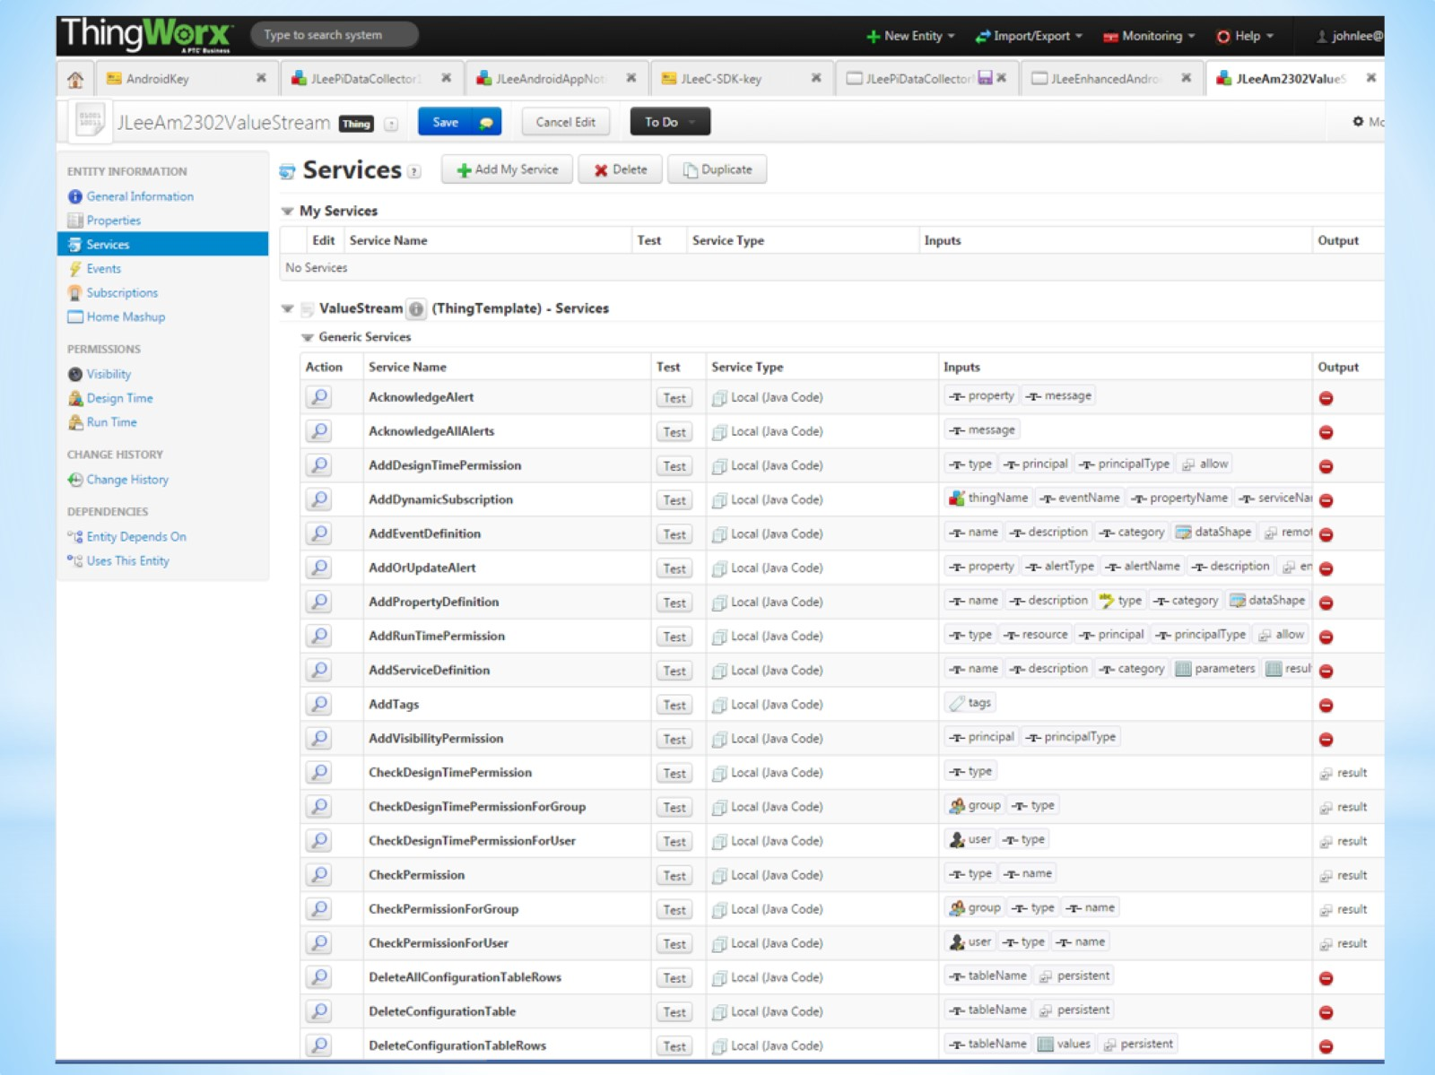

Slide 27
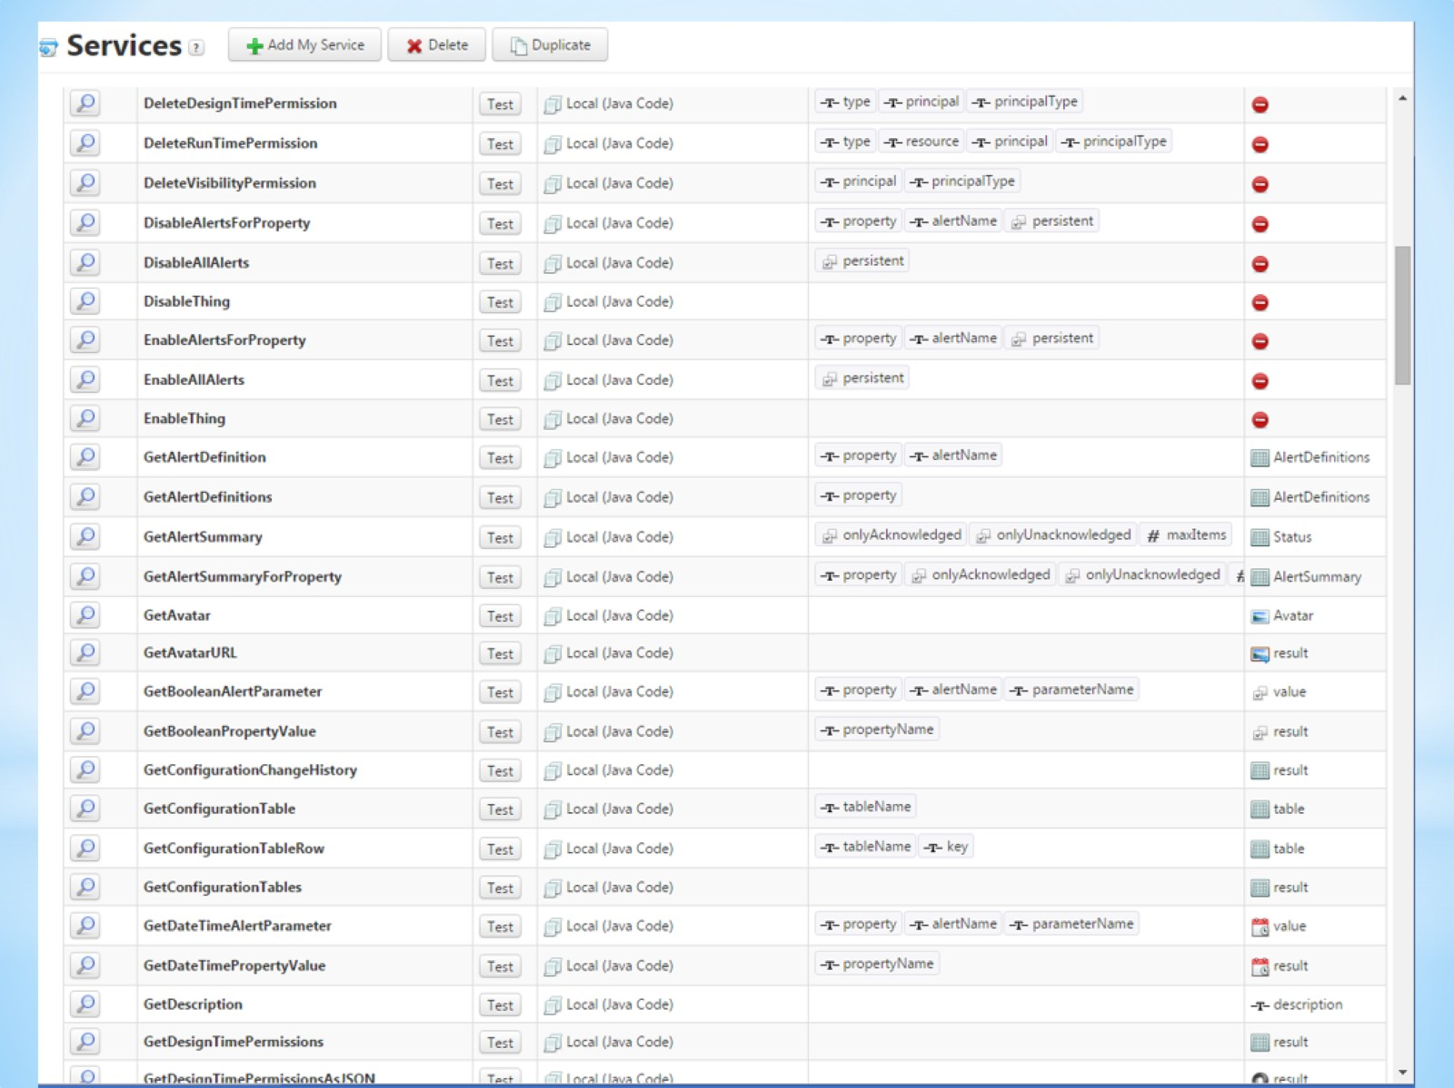

Slide 28
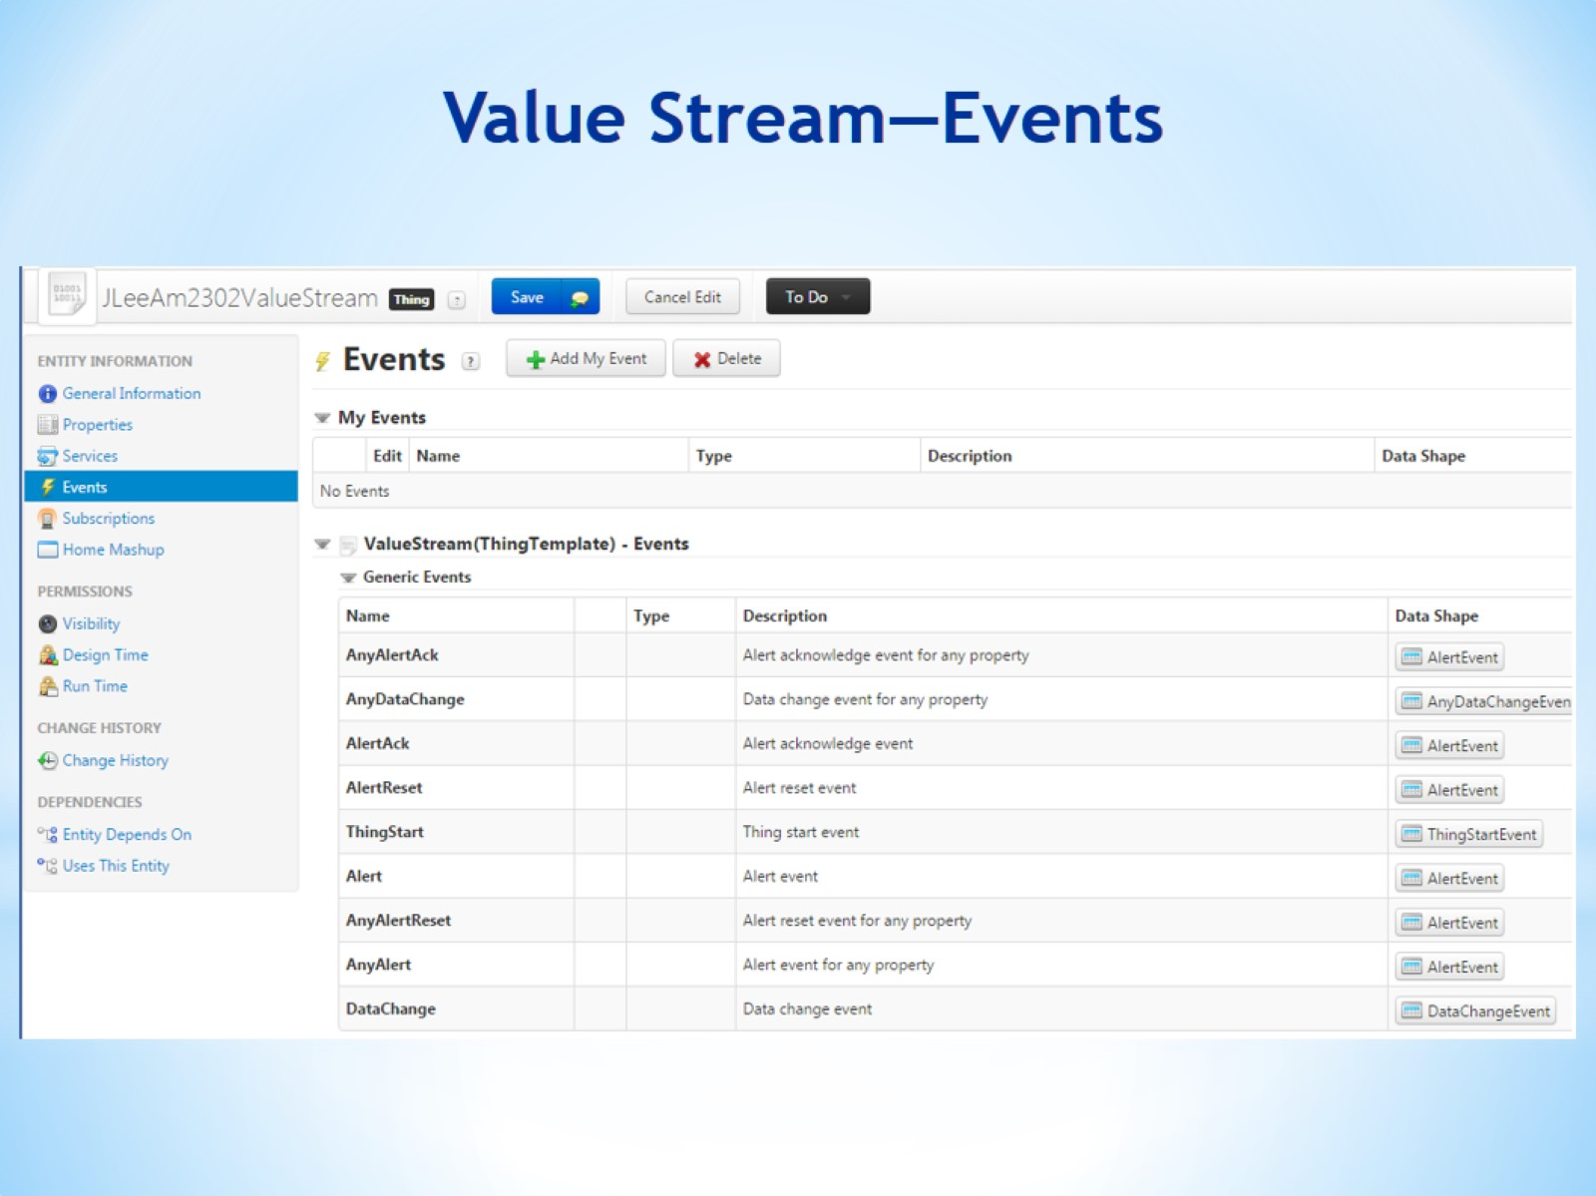
Value Stream—Events

Slide 29
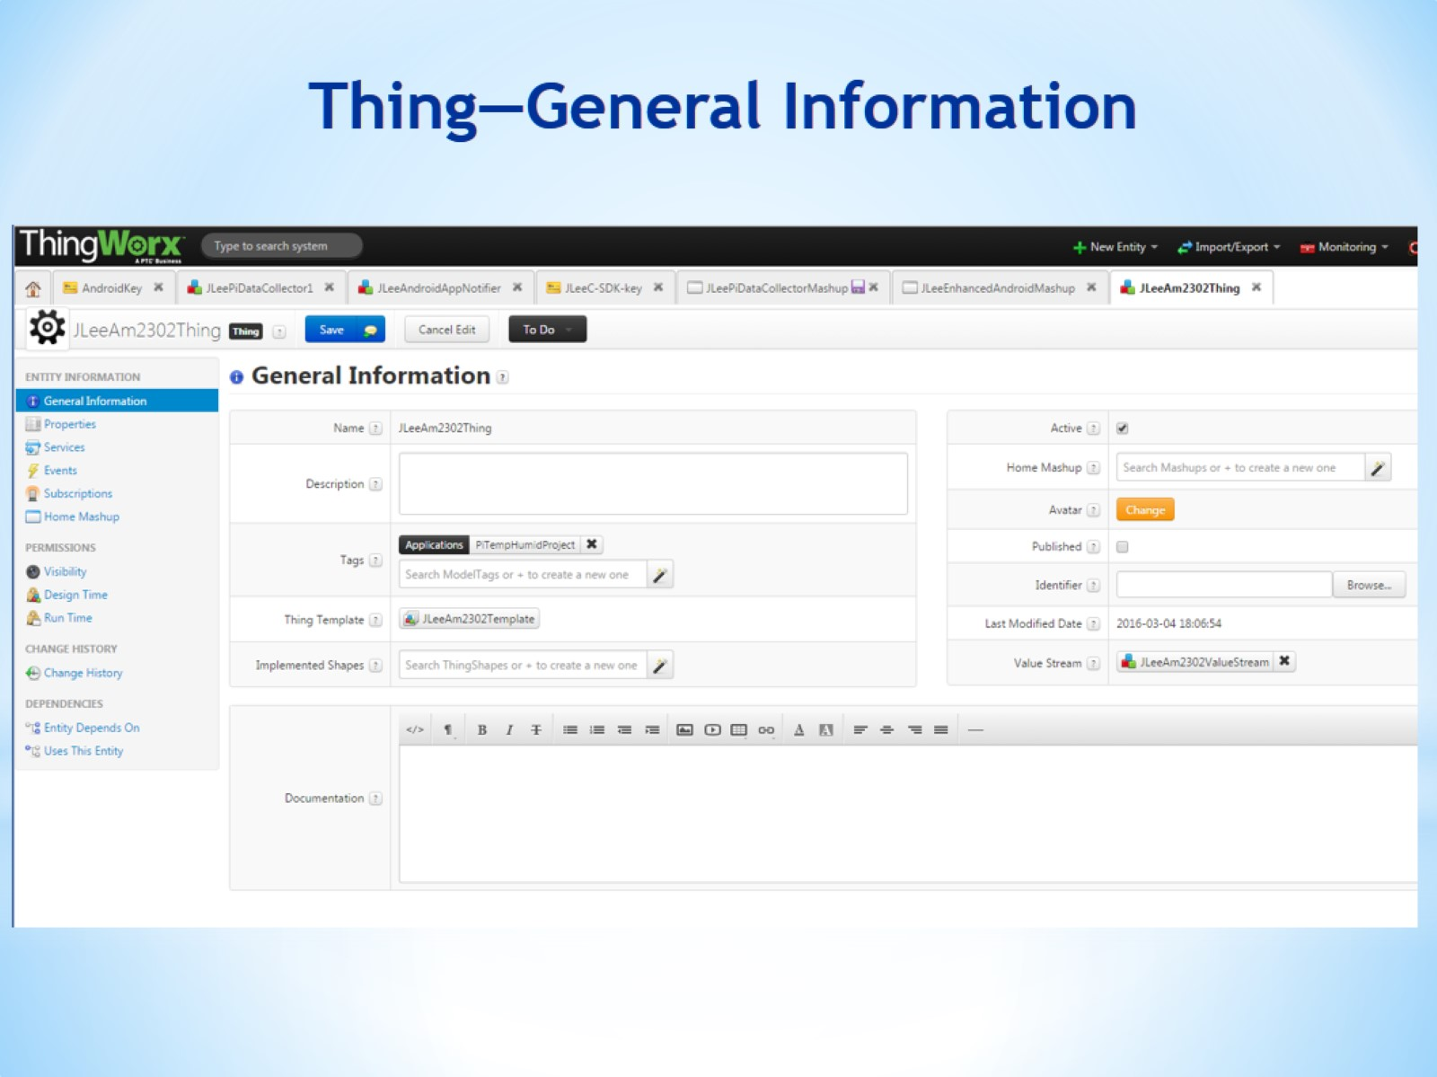
Thing—General Information

Slide 30
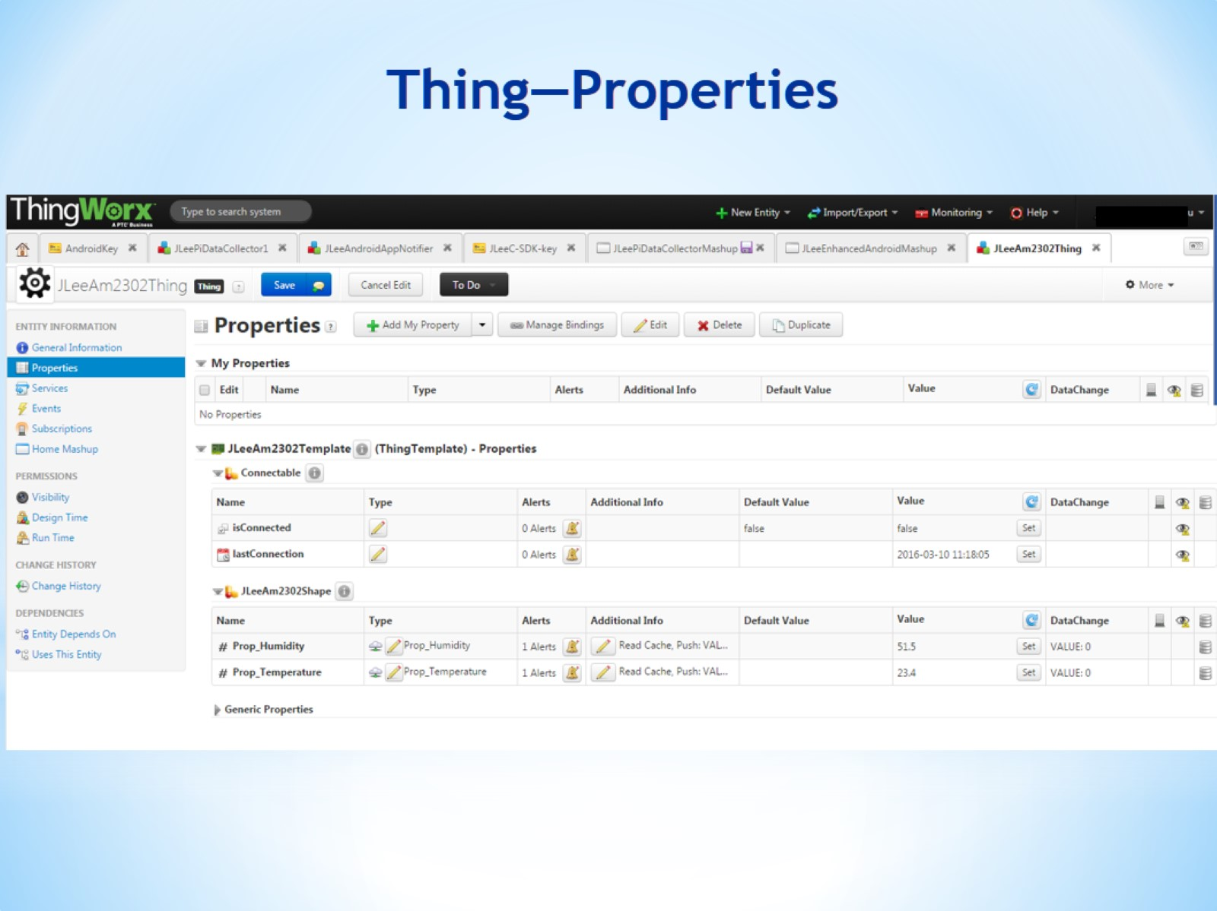
Thing—Properties

Slide 31
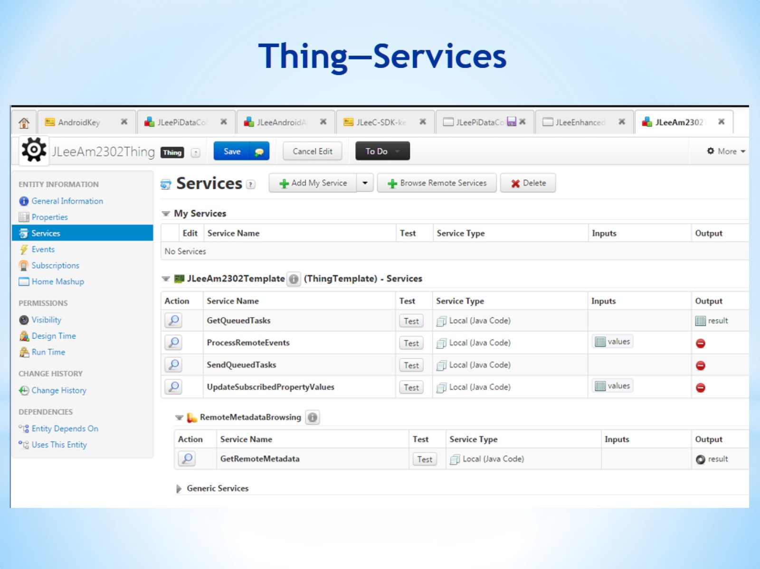
Thing—Services

Slide 32
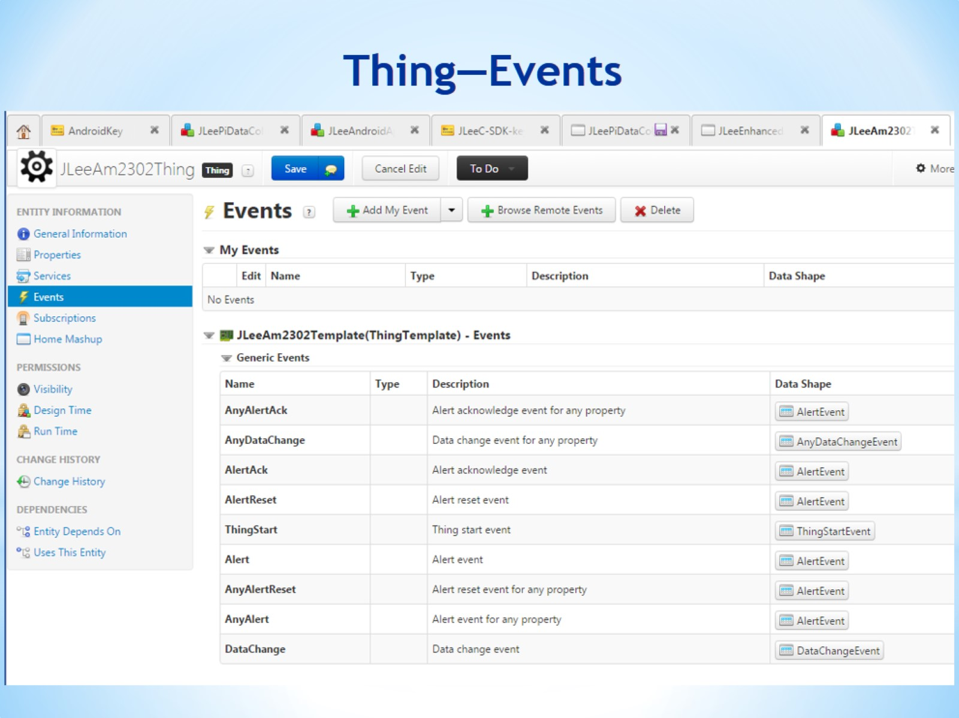
Thing—Events

Slide 33
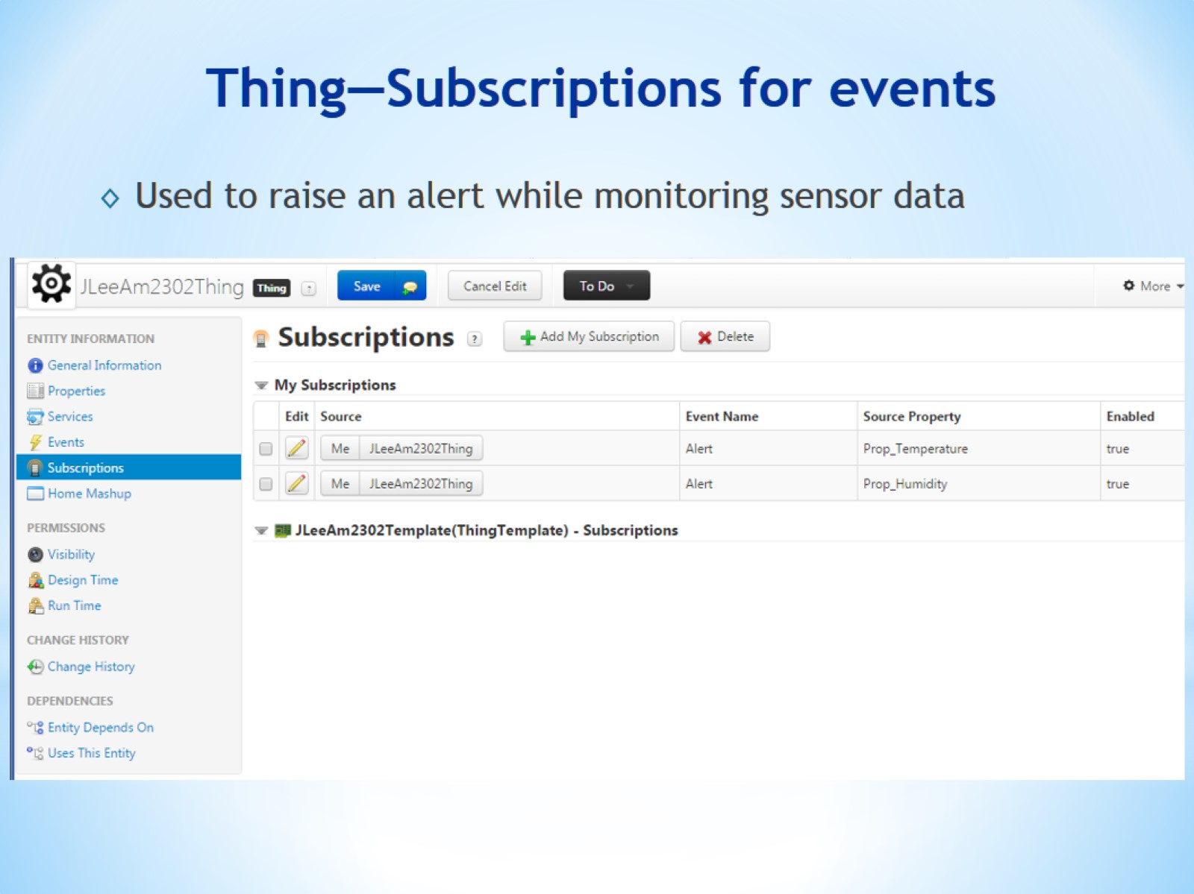
Thing—Subscriptions for events

Slide 34
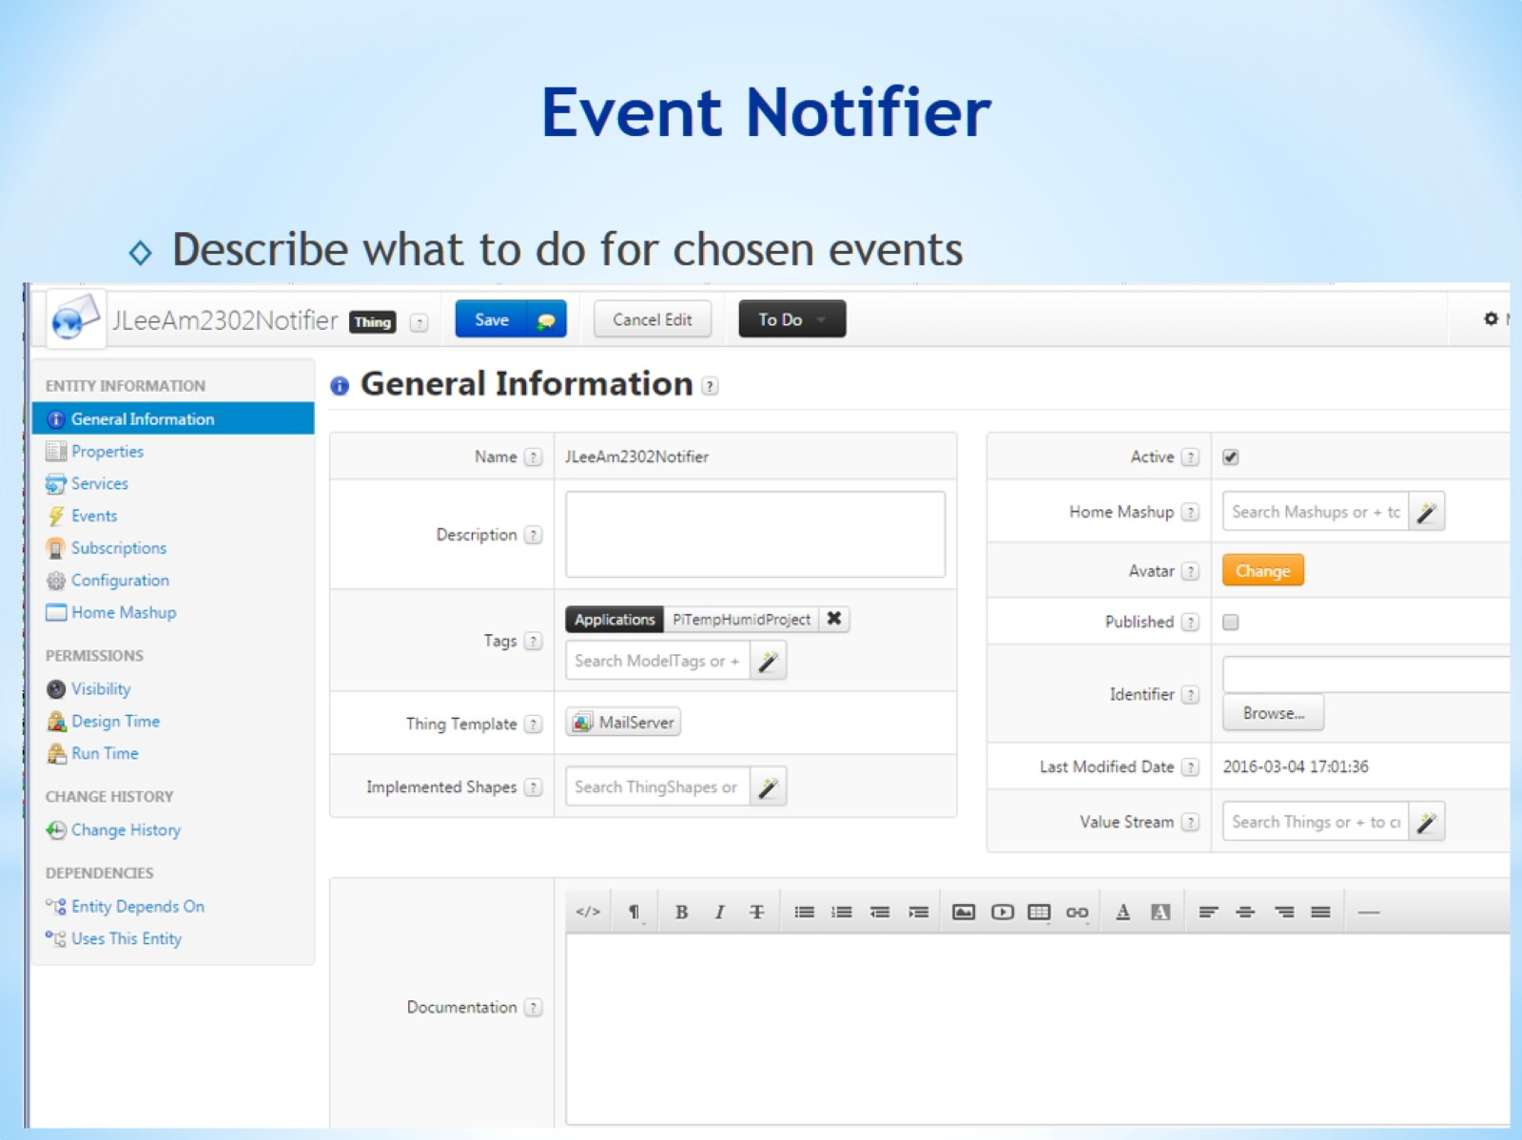
Event Notifier

Slide 35
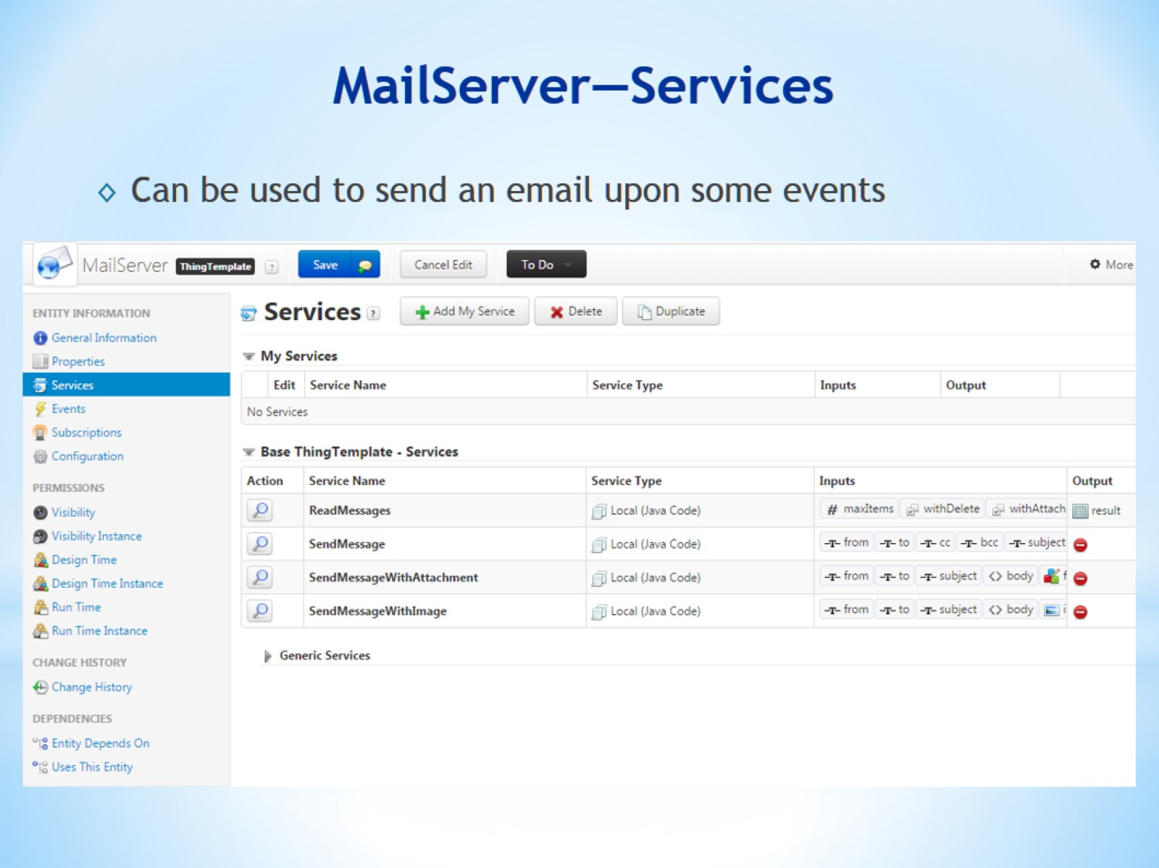
MailServer—Services

Slide 36
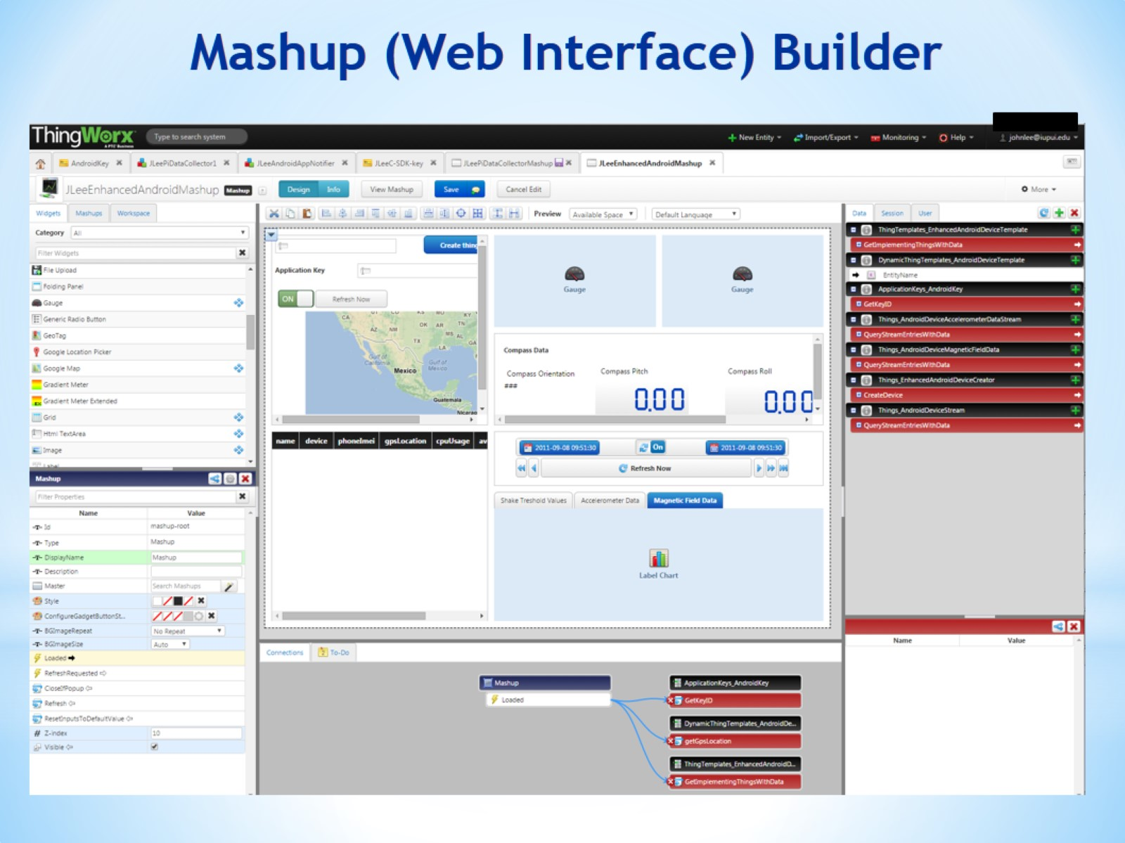
Mashup (Web Interface) Builder

Slide 37
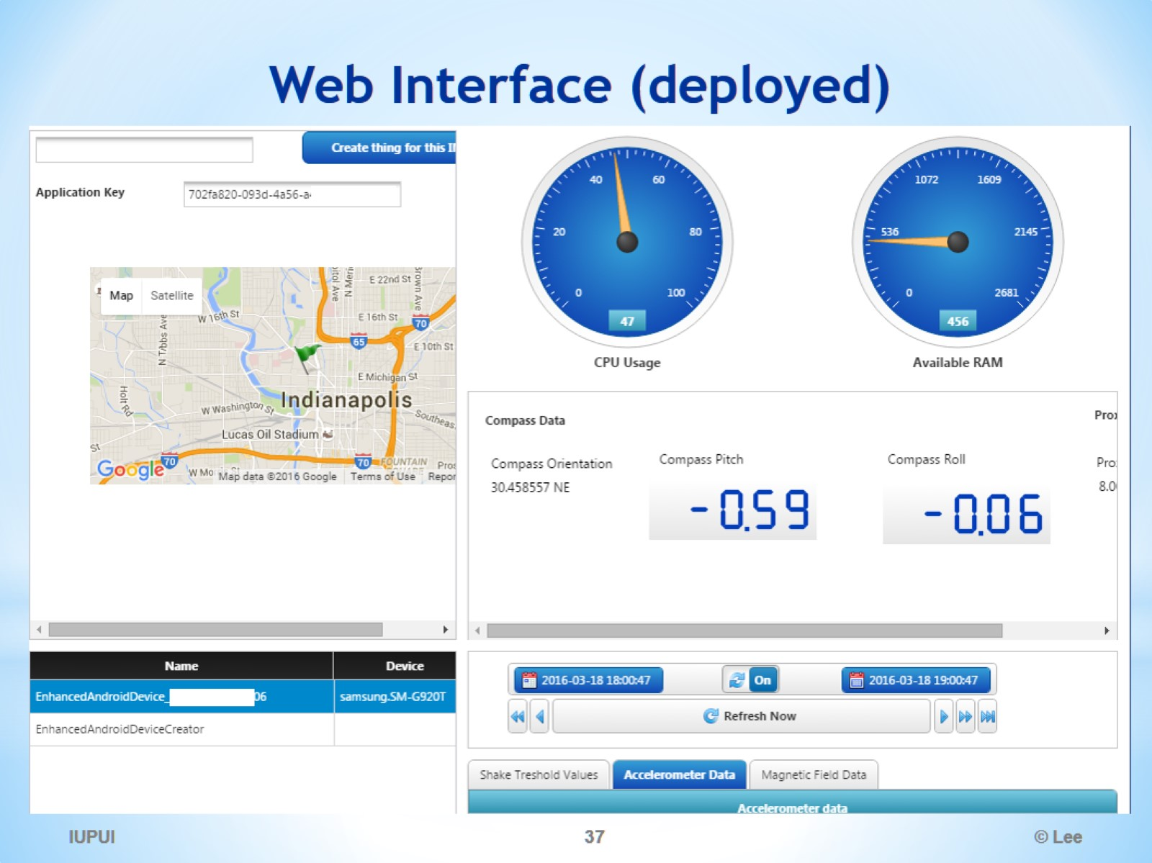
Web Interface (deployed)

Slide 38
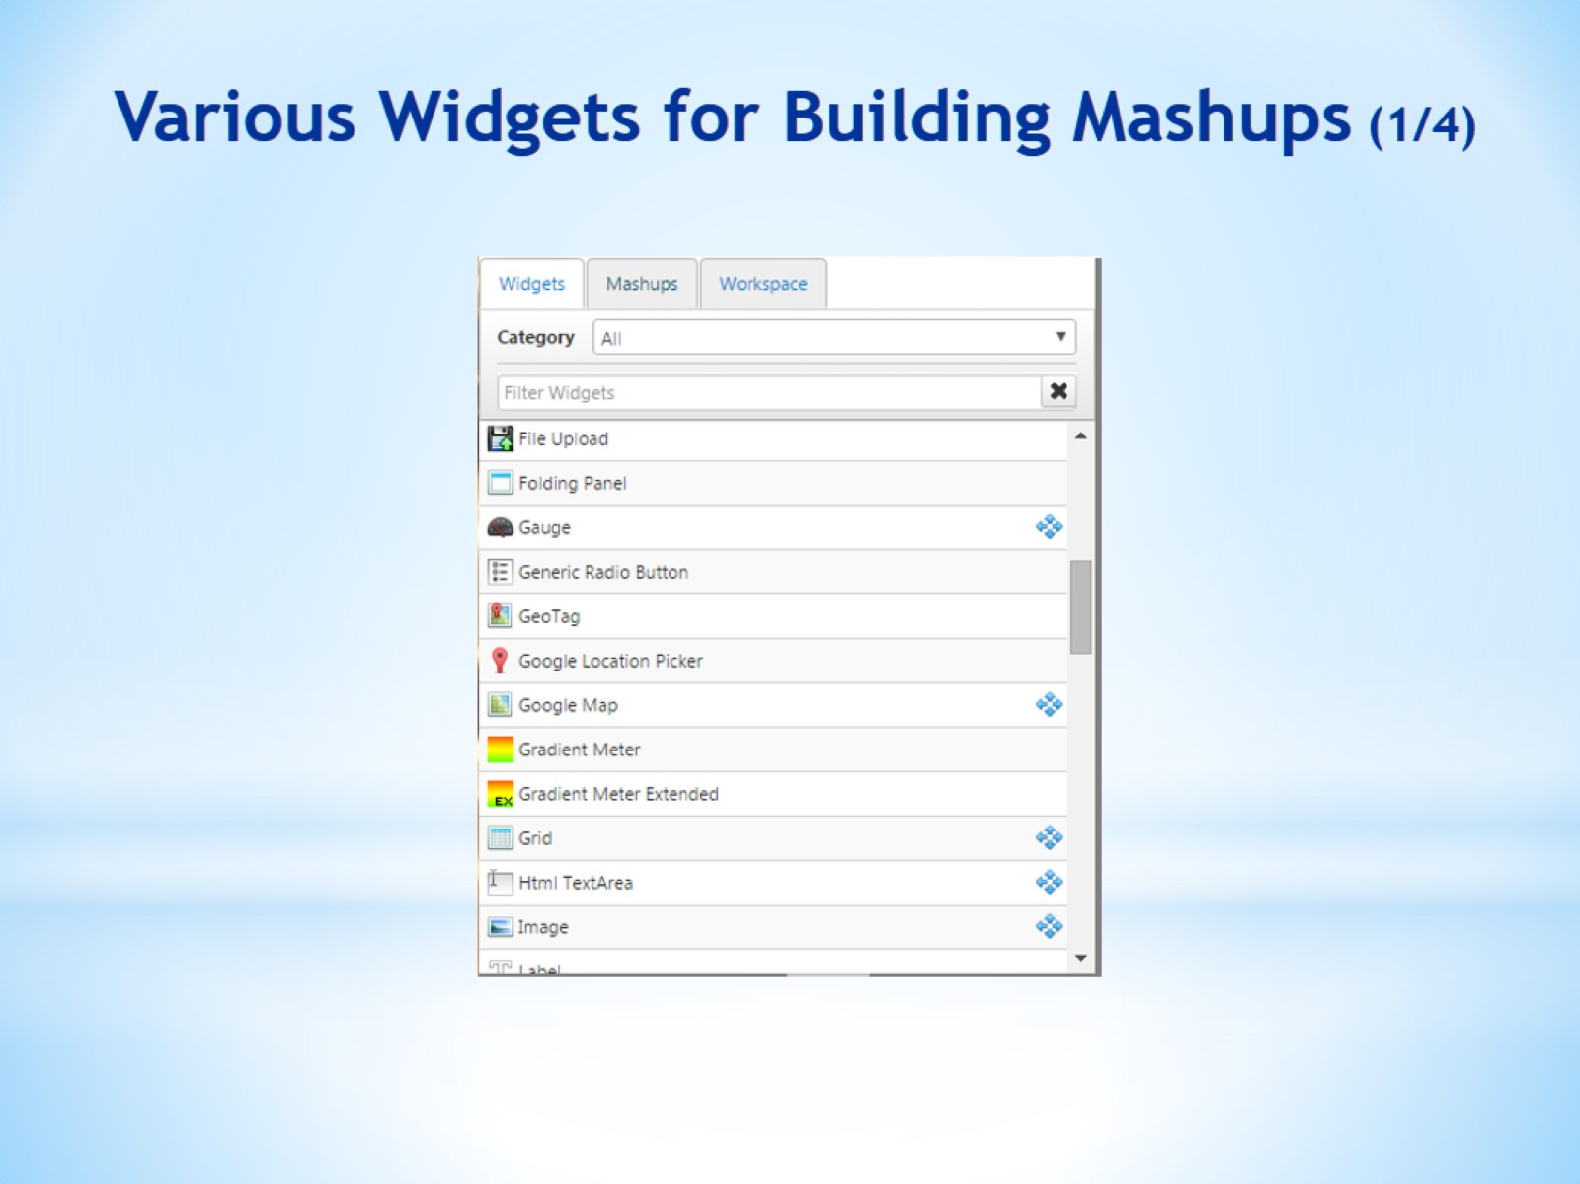
Various Widgets for Building Mashups (1/4)

Slide 39
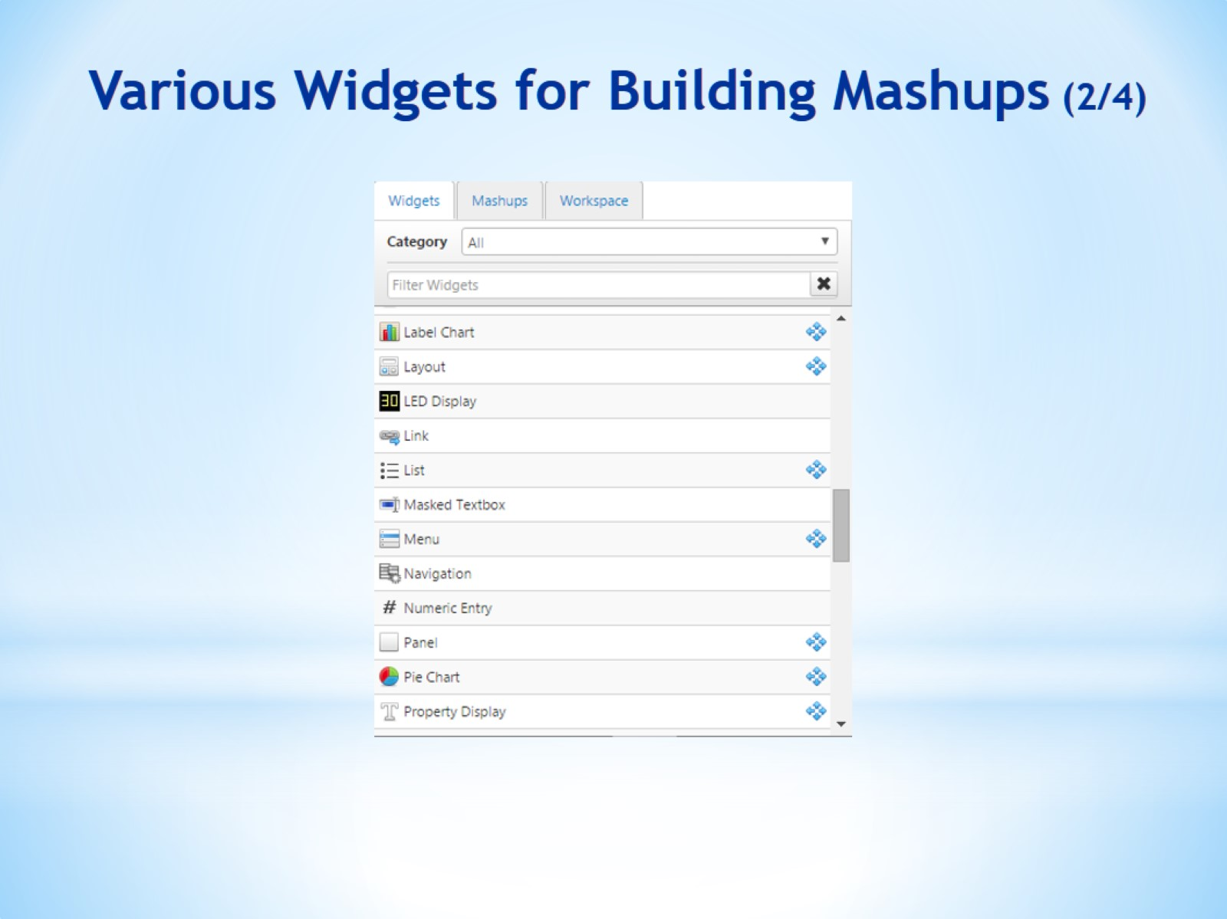
Various Widgets for Building Mashups (2/4)

Slide 40
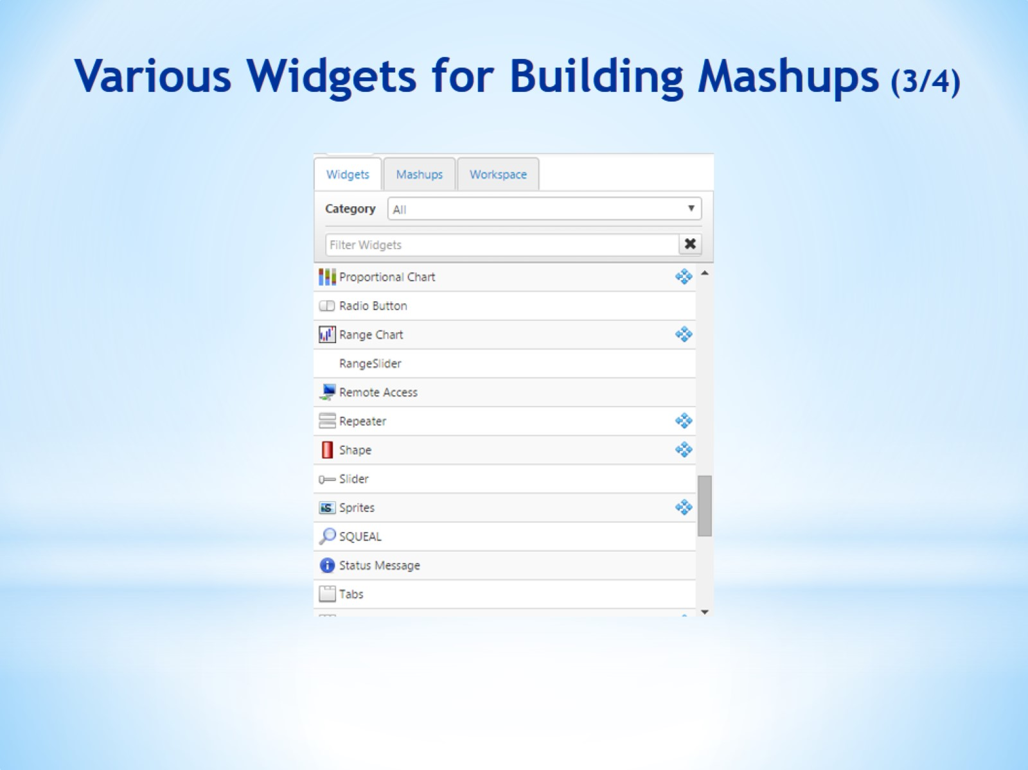
Various Widgets for Building Mashups (3/4)

Slide 41
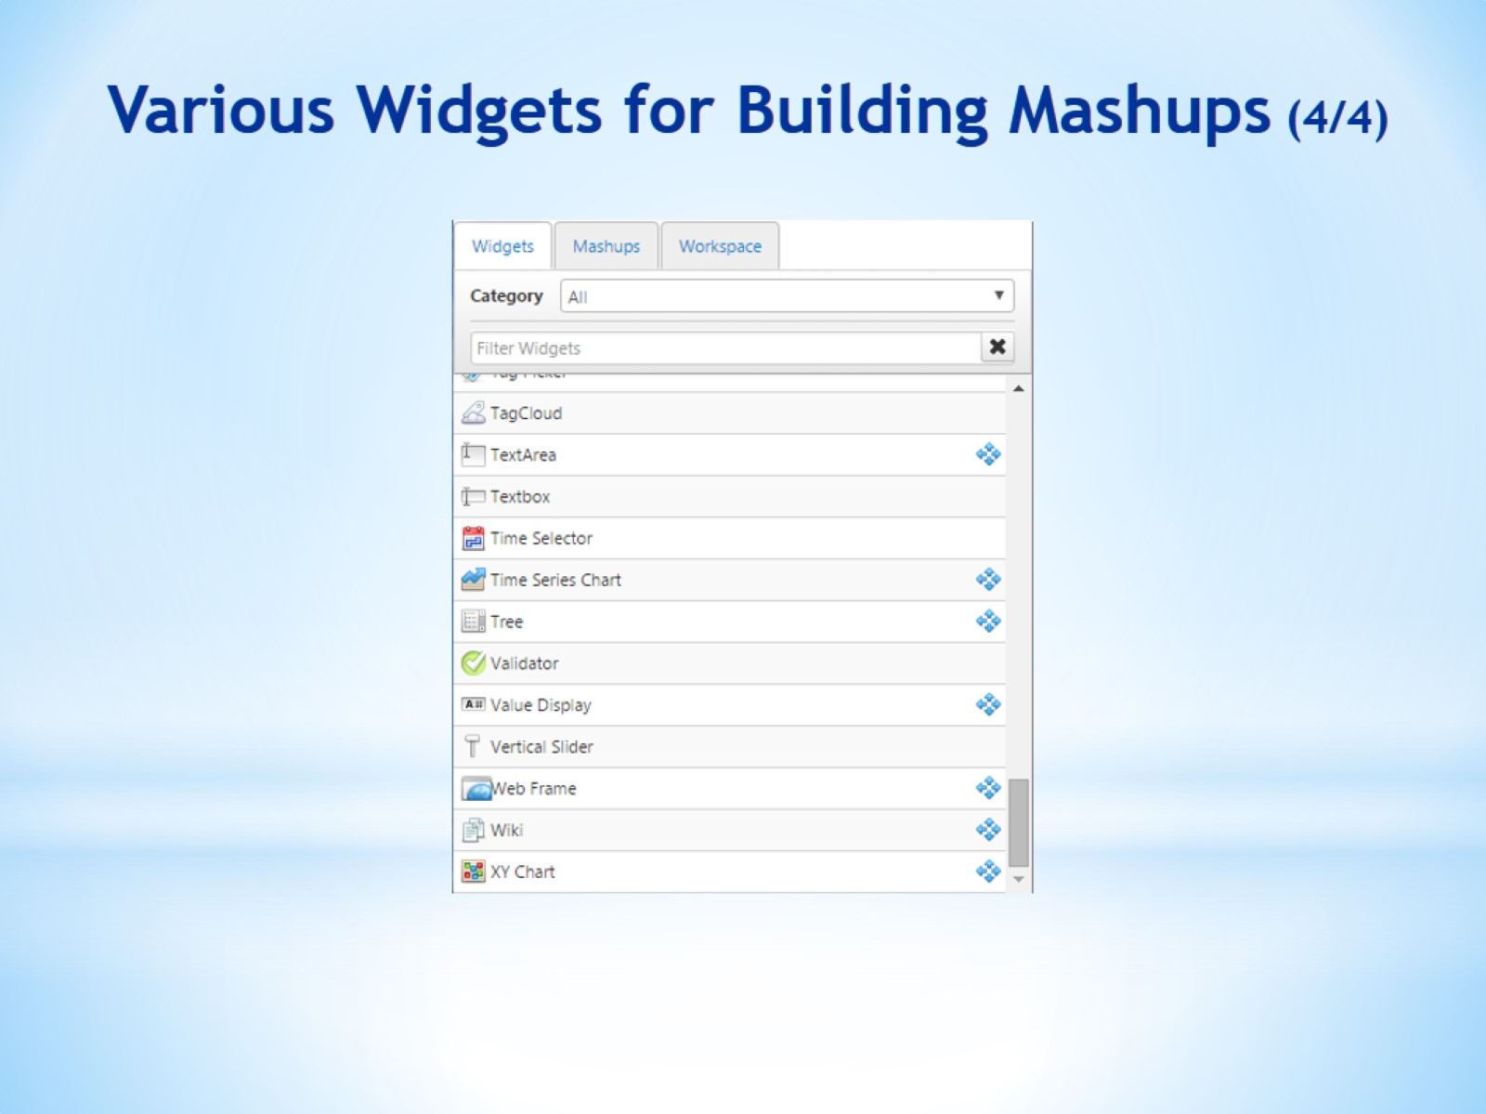
Various Widgets for Building Mashups (4/4)

Slide 42
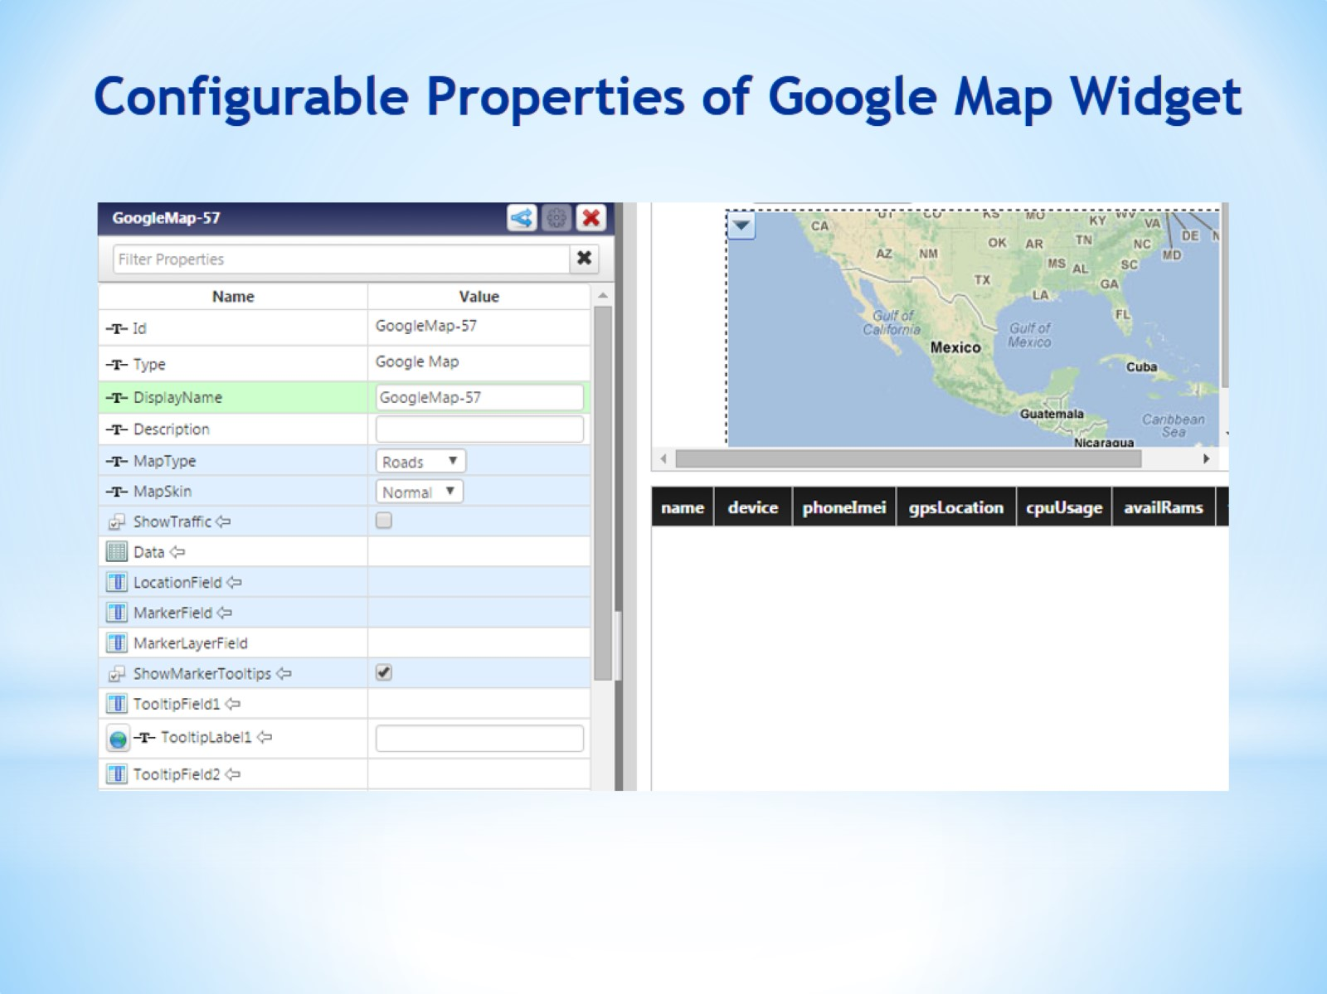
Configurable Properties of Google Map Widget

Slide 43
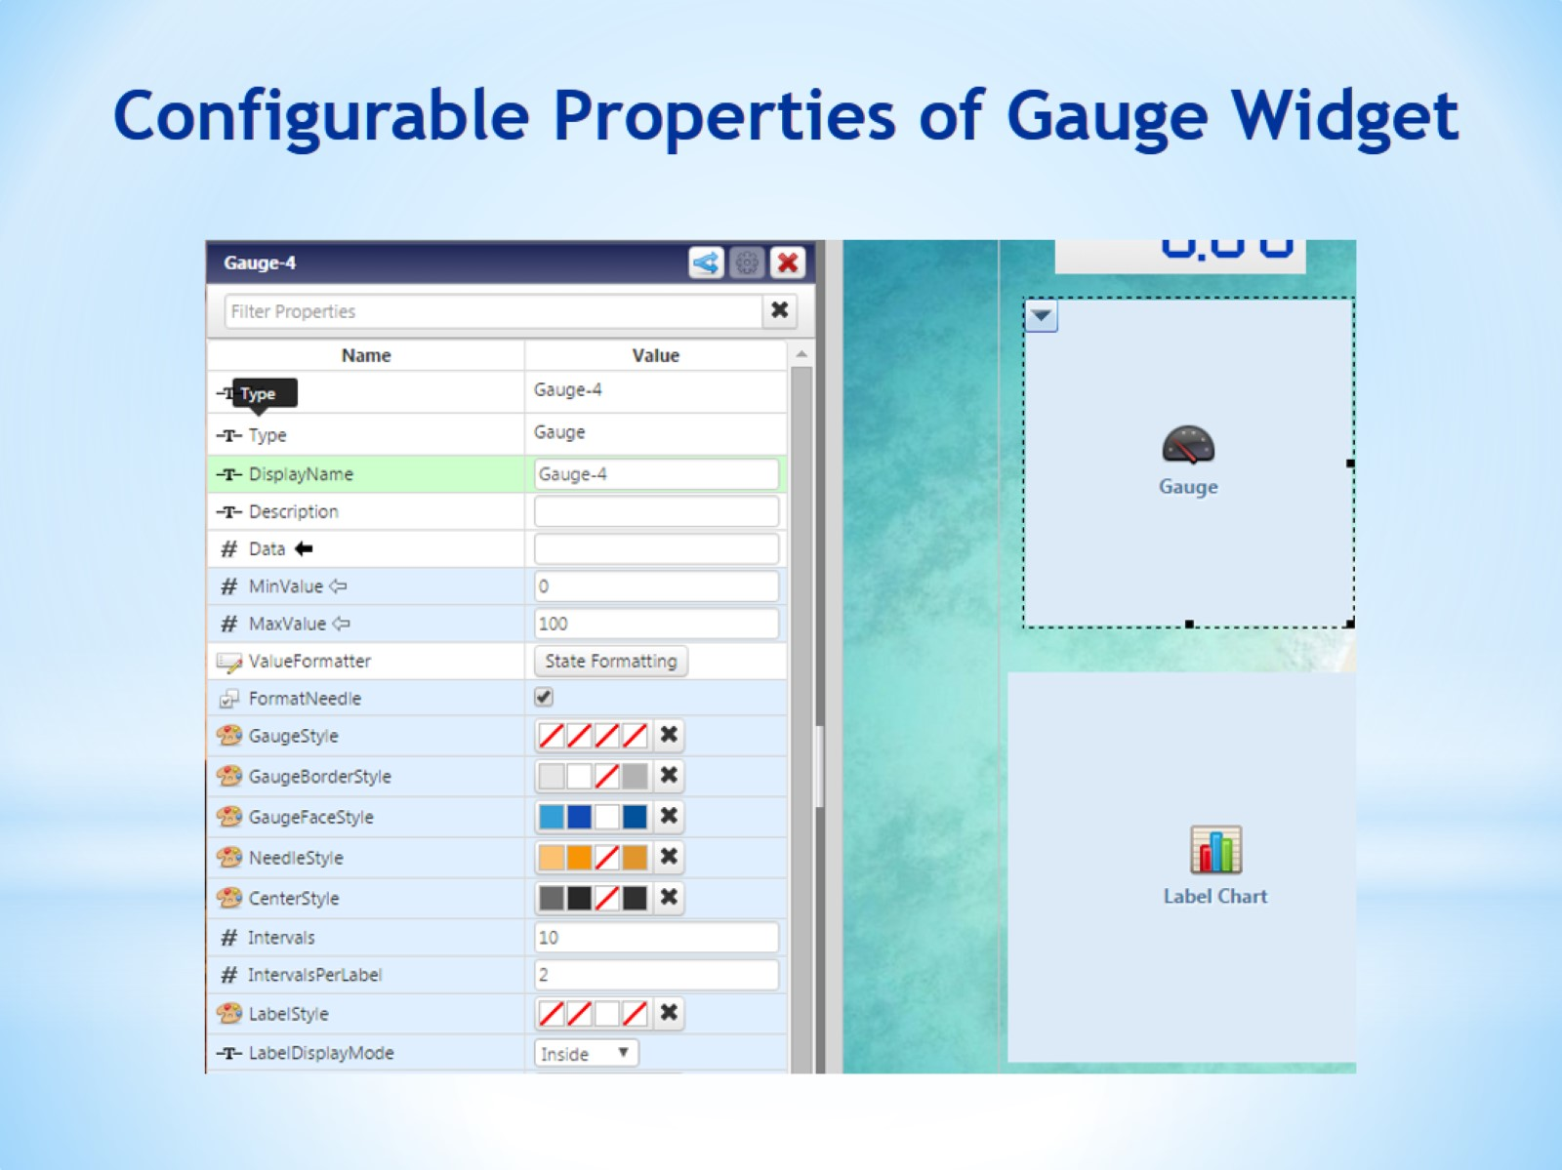
Configurable Properties of Gauge Widget

